Slide 1

OPEN SEMINAR Biometric Template Protection using Cancelable Biometrics and Visual Cryptography
Presented By:
Harkeerat Kaur, 1220131
Research Scholar (CSE)
Under Supervision of:
Dr. Pritee Khanna
August 14, 2017

Slide 2
Contents
Introduction
Research Gap and Contributions
Proposed Template Transformation Schemes
Random Projection based template transformation.
XOR based template transformation.
Random Distances based template transformation.
Random Slope based template transformation.
Polynomial based template transformation.
Proposed Advance Template Protection using Secret Sharing
Proposed Remote Authentication Architecture
Conclusions
References
Publications

Slide 3
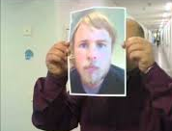
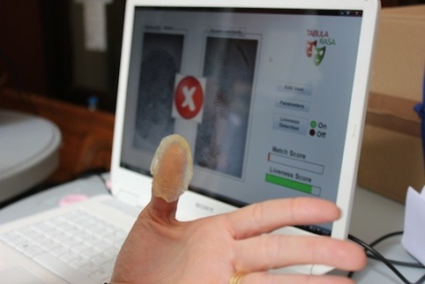
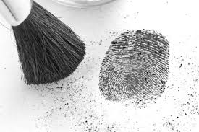
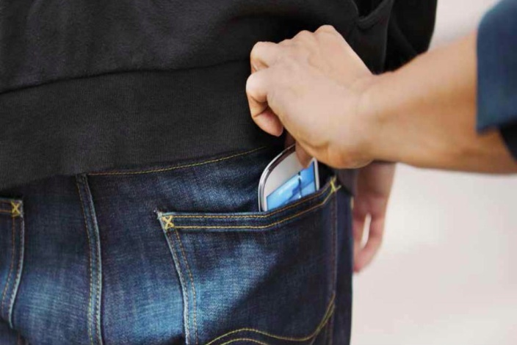
Biometrics - A Double Edged Sword
Biometrics - the most advanced security solutions in the market.
Biometrics offers greater security and convenience than traditional methods of personal recognition.
Biometrics for security and security for biometrics
Risks - Leaking a Biometric is a Disaster
Password leaked? Fine, you can easily replace with a new one.
Fingerprint leaked? Leaked for the rest of your life.
Lack of general solutions leaves this as a challenging issue.
Notes:
cannot be forgotten, difficult to forge, and provides a very strong access control security solution satisfying authentication, confidentiality, integrity, and non-repudiation.
Due to the rapid growth in sensing and computing technologies, biometric systems have become affordable and are easily embedded in a variety of consumer devices (e.g., mobile phones, key fobs, etc.), making this technology vulnerable to the malicious designs of terrorists and criminals.
A framework is proposed to solve this problem

Slide 4
Biometric Template Protection
Template Protection
Hardware level
Software level
Protocol level
Multi-party communication
Hommomorphic communication
Private information retrieval
Tamperproof h/w
Smartcard assisted h/w
Trusted platform
Cryptosystems
Feature Transformation
Template Image Transformation
Cancelable Biometrics
Key-binding
Key-generation
Biometric Salting
Non-invertible transforms
Steganography
Watermarking
Visual crypto-graphy
Biometric Encryption
Fuzzy vault
Fuzzy commitment
Quantization
Fuzzy extractor
Secure sketches
Random projection
Random con-volution
Random noise
Surface folding
Biotokens
Block permutations

Slide 5
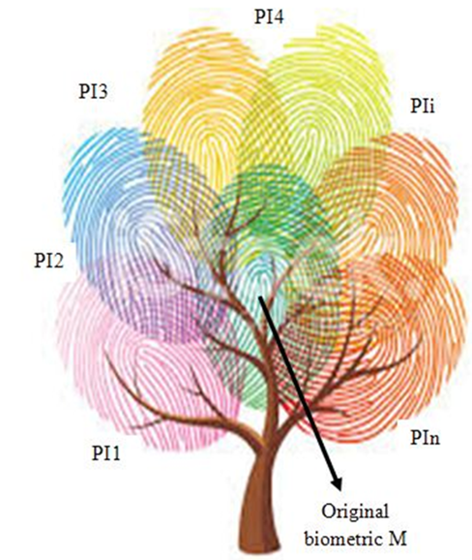
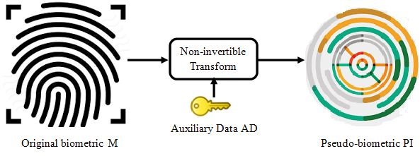
Cancelable Biometrics
Regenerate biometrics like passwords.
Use ‘pseudo-identity’ PI instead of original biometric for storing, matching and other authentication tasks.
Assign a token to every enrollee which generates/lead to generate this user-specific secret information, AD.
In case of a compromise only pseudo-identity PI is lost, which cannot be inverted to learn original biometric.
Notes:
Transform biometric M, in a non-invertible manner, to generate ‘pseudo-identity (PI)’ using user-specific secret information /auxiliary data, AD.
A new pseudo-identity can be regenerated by changing transformation function/parameters.
Same biometric maps to different pseudo-identities for secure usage over multiple applications.
This way user is free from intrusions, remains autonomous and retains control over the use of its biometric information.

Slide 6
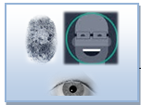

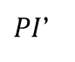
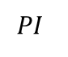
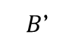
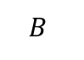
Basic Cancelable Authentication System
ENROLLMENT
Process biometrics
Original biometric is discarded after generating pseudo-biometric
$$B$$
Cancelable transformation
Input biometric
Pseudo-biometric identity (PI)
Random Data Generation
token
Database Server
AUTHENTICATION
Process biometrics
$$PI$$
Matching without decryption
$B$’
Cancelable transformation
$PI$’
Matcher
Input biometric and user specific token
token
Accept/ Reject

Slide 7
Properties of Cancelable Transform
Four important requirements [8]
Revocability : Straight forward revocation of a compromised template.
Diversity: No correlation/cross-matching of pseudo-identities.
Non-invertibility: No possibility to recover original identity by inverting pseudo-identity.
Performance: Discriminative content of biometric template must be preserved. FAR/FRR must be low.
Transforming a biometric template in a revocable manner such that it fulfills all the four criteria of revocability, diversity, non-invertibility and performance is a challenging task!

Slide 8
Major Transformation Schemes
Biometric salting
Random Projection: BioHashing , Multiple Random Projections
Random Convolution: BioConvolving, Random kernels, curtailed circular convolution
Random Permutations: Block permutation, GRAY/BIN-COMBO
Random Addition: BioPhasoring, GRAY/BIN-SALTING
Non-invertible transforms
Geometric transforms- Cartesian, Surface and Polar transforms [9]
Hash functions etc.
There exists many drawbacks for the schemes as analyzed during literature survey.
Notes:
GRAY-COMBO, transforms the Gabor features by circularly
shifting and adding rows at random. BIN-COMBO, the second
method, applies similar transformations on the iris codes by random
shifting and XOR-ing.
GRAY-SALTING, BIN-SALTING
These methods add random
patterns or synthetic iris patterns to the Gabor features

Slide 9
Research Gap
Limited number of biometric salting techniques, many of which are susceptible to inverse.
Non-invertible transforms tend to trade-off discriminability.
Performance for most approaches are evaluated only for best-case scenario.
Best-case: different tokenized data to each user
Worst-case: same tokenized data to each user
Applicability of most transforms is restricted only to particular modalities.
In general, biometric recognition techniques have to deal with the problem of high storage requirements due to large template sizes.

Slide 10
Objectives & Contributions
To improve existing techniques and to discover new transformation techniques for generating secure, privacy preserving, and revocable biometric templates with reduced dimensionality.
Signal level transformations:
Random Project based template transformation
Feature level transformations:
XOR based template transformation
Random distance based template transformation
Random slope based template transformation
Polynomial based template transformation
Visual cryptography for advance protection:
Sharing transformed features using innocuous images
A secure architecture for remote authentication in multi-server environment

Slide 11
Performance Metrics
Matching Performance:
Verification (1:1): Equal Error Rate (EER) and Decidability Index (DI)
Identification (1:N): Correct Recognition Rate (RI).
Desirable: (1) low EER, high DI, high RI; (2) worst-case performance must be comparable to original; (3) Best-case better.
Changeability Performance:
Correlation Index (CI), Cross-matching EER, and genuine, impostor and pseudo-impostor population distribution statistics.
Desirable: (1) low CI, high EER; (2) Genuine different from impostor and pseudo-impostor resembles impostor.
Non-invertibility:
Separately analyzed for each approach.

Slide 12
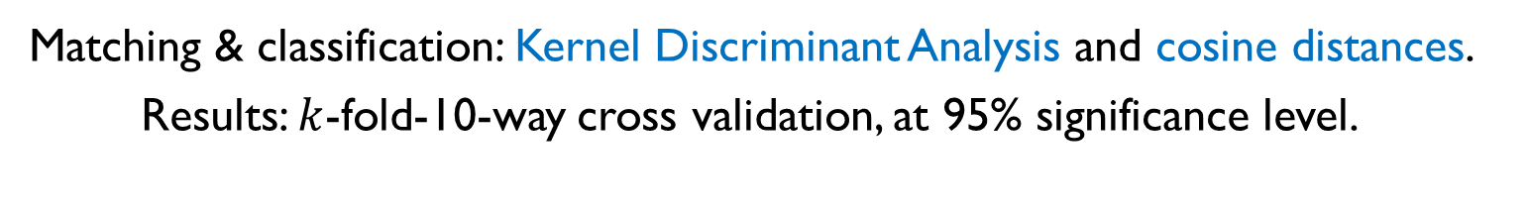
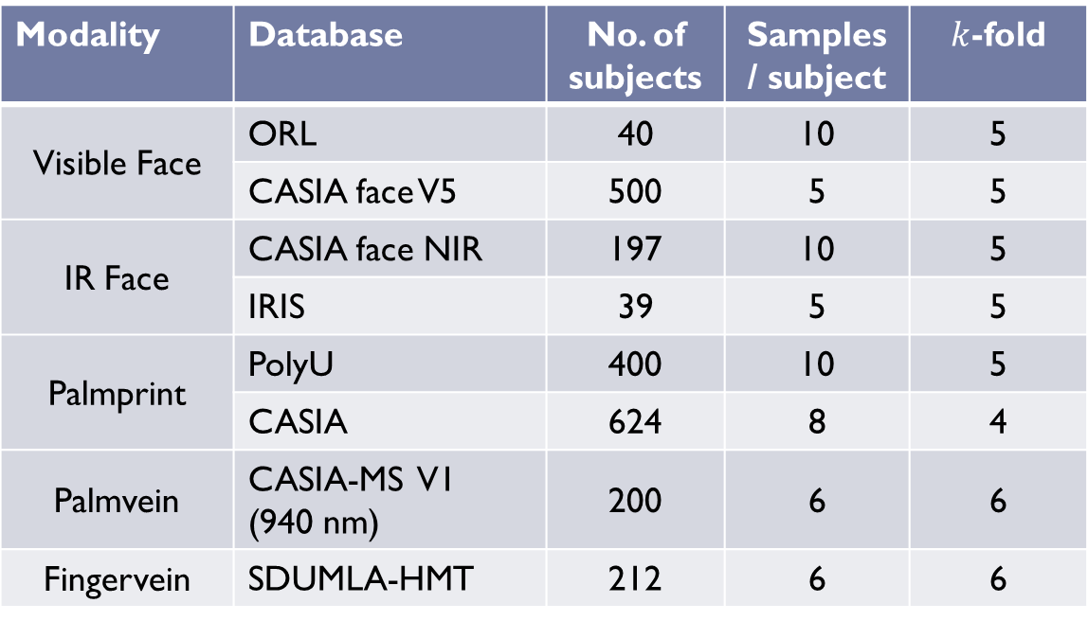
Databases used for Experimentation
Modality | Database | No. of subjects | Samples / subject | $k$-fold
Visible Face | ORL | 40 | 10 | 5
 | CASIA face V5 | 500 | 5 | 5
IR Face | CASIA face NIR | 197 | 10 | 5
 | IRIS | 39 | 5 | 5
Palmprint | PolyU | 400 | 10 | 5
 | CASIA | 624 | 8 | 4
Palmvein | CASIA-MS V1 (940 nm) | 200 | 6 | 6
Fingervein | SDUMLA-HMT | 212 | 6 | 6
Matching & classification: Kernel Discriminant Analysis and cosine distances.
Results: $k$-fold-10-way cross validation, at 95% significance level.

Slide 13
1. Random Projection based Template Transformation

Slide 14
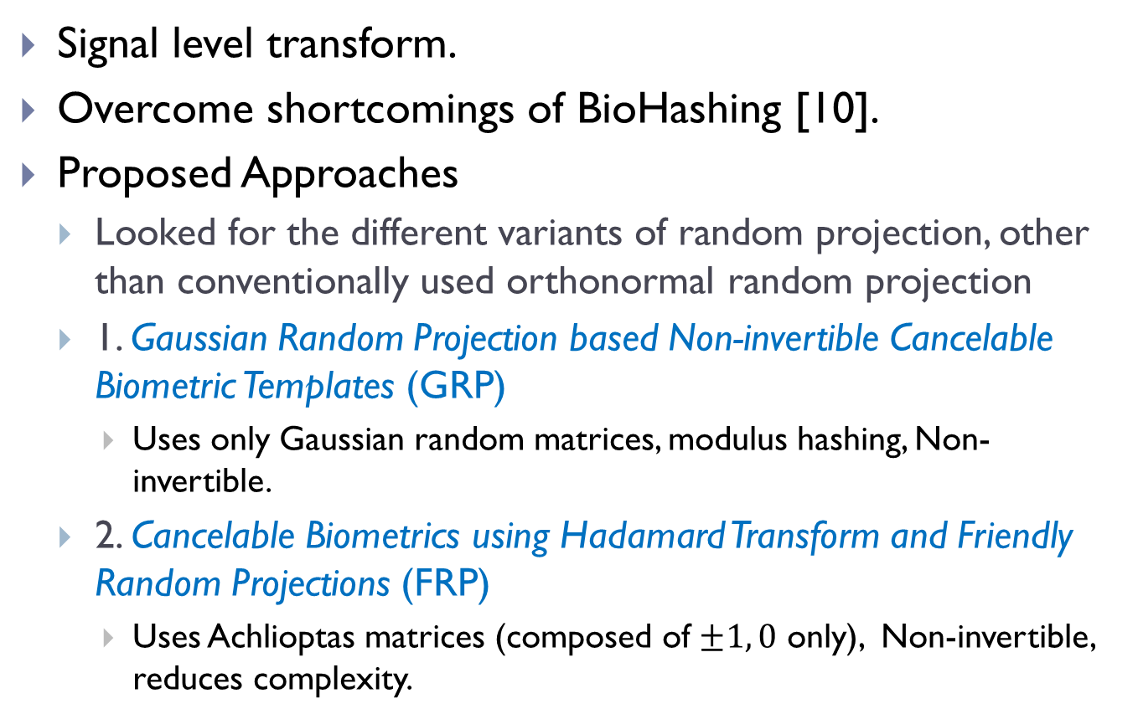
Random Projection based Techniques
Signal level transform.
Overcome shortcomings of BioHashing [10].
Proposed Approaches
Looked for the different variants of random projection, other than conventionally used orthonormal random projection
1. Gaussian Random Projection based Non-invertible Cancelable Biometric Templates (GRP)
Uses only Gaussian random matrices, modulus hashing, Non-invertible.
2. Cancelable Biometrics using Hadamard Transform and Friendly Random Projections (FRP)
Uses Achlioptas matrices (composed of $±1, 0$ only), Non-invertible, reduces complexity.

Slide 15
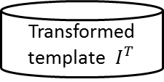
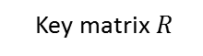
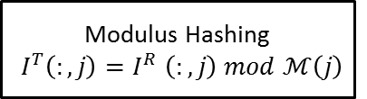
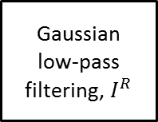
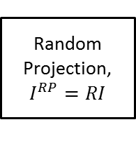
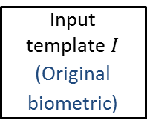
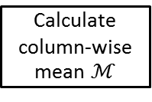
Proposed Approach – GRP
Gaussian Random Projection based transformation
Gaussian low-pass filtering, $I^{R}$
Non-invertible operations by filtering and hashing
Input template $I$
(Original biometric)
Random Projection,
$$I^{RP}=RI$$
Calculate column-wise mean $ℳ$
Modulus Hashing
$${ I}^{T}\left(:,j\right){=I}^{R}\left(:,j\right) mod ℳ\left(j\right)$$
Transformed template ${ I}^{T}$
user- specific token
Signal level salting using Random Projection
Key matrix $R$
(Pseudo-biometric)
H. Kaur, P. Khanna, “Gaussian random projection based non-invertible cancelable biometric templates,” Procedia Computer Science, vol. 54, pp. 661–670, 2015.
Notes:
The Gaussian smoothing operator is a 2-D convolution operator that is used to `blur' images and remove detail and noise. In this sense it is similar to the mean filter, but it uses a different kernel that represents the shape of a Gaussian (`bell-shaped') hump.
The Gaussian outputs a `weighted average' of each pixel's neighborhood, with the average weighted more towards the value of the central pixels
This is in contrast to the mean filter's uniformly weighted average. Because of this, a Gaussian provides gentler smoothing and preserves edges better than a similarly sized mean filter.

Slide 16
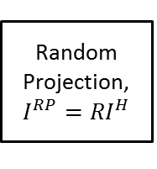
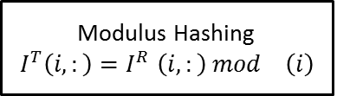
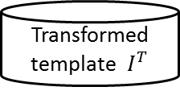
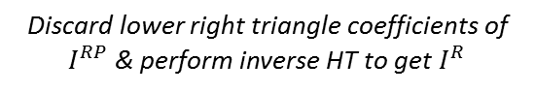
Proposed Approach – FRP
Friendly Random Projections based transformation.
Discard lower right triangle coefficients of $I^{RP}$ & perform inverse HT to get $I^{R}$
Non-invertible operations by discarding information and hashing
Input template $I$
(Original biometric)
Forward HT
Random Projection,
$$I^{RP}={RI}^{H}$$
Calculate column-wise mean M
Modulus Hashing
$${ I}^{T}\left(i,:\right){=I}^{R}\left(i,:\right) mod \left(i\right)$$
HT - Hadamard transform
Signal level salting using Random Projection
Transformed template ${ I}^{T}$
user- specific token
Key matrix $R$
(Pseudo-biometric)
H. Kaur, P. Khanna, “Cancelable Biometrics Using Hadamard Transform and Friendly Random Projections”, In Proceedings of International Conference on Computer Vision and Image Processing. Advances in Intelligent Systems and Computing, vol 460, 2016, Springer.

Slide 17
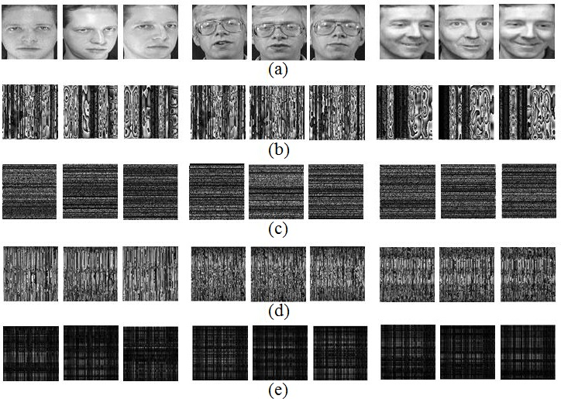
Non-invertibility
Fig. 1. (a) Original face templates, (b)-(c) Transformed and recovered templates for GRP, and
(d)-(e) Transformed and recovered templates for FRP.

Slide 18
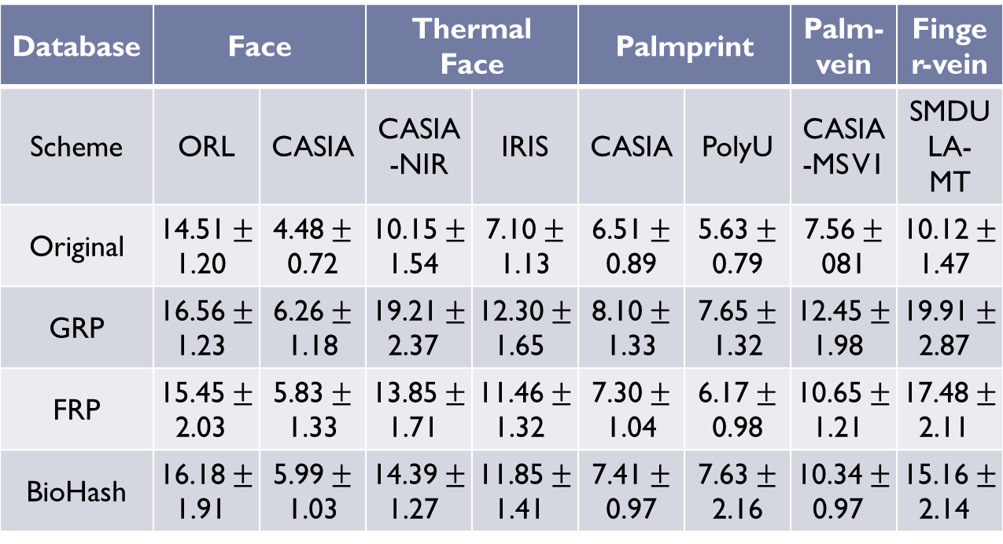
Matching Performance- (EER%) at 95% significance level
Database | Face |  | Thermal Face |  | Palmprint |  | Palm-vein | Finger-vein
Scheme | ORL | CASIA | CASIA-NIR | IRIS | CASIA | PolyU | CASIA-MS V1 | SMDULA-MT
Original | $\text{14.51}±$1.20 | $\text{4.48}±$0.72 | $\text{10.15}±$1.54 | $\text{7.10}±$1.13 | $\text{6.51}±$0.89 | $\text{5.63}±$0.79 | $\text{7.56}±$081 | $\text{10.12}±$1.47
GRP | $\text{16.56}±$1.23 | $\text{6.26}±$1.18 | $\text{19.21}±$2.37 | $\text{12.30}±$1.65 | $\text{8.10}±$1.33 | $\text{7.65}±$1.32 | $\text{12.45}±$1.98 | $\text{19.91}±$2.87
FRP | $\text{15.45}±$2.03 | $\text{5.83}±$1.33 | $\text{13.85}±$1.71 | $\text{11.46}±$1.32 | $\text{7.30}±$1.04 | $\text{6.17}±$0.98 | $\text{10.65}±$1.21 | $\text{17.48}±$2.11
BioHash | $\text{16.18}±$1.91 | $\text{5.99}±$1.03 | $\text{14.39}±$1.27 | $\text{11.85}±$1.41 | $\text{7.41}±$0.97 | $\text{7.63}±$2.16 | $\text{10.34}±$0.97 | $\text{15.16}±$2.14

Slide 19
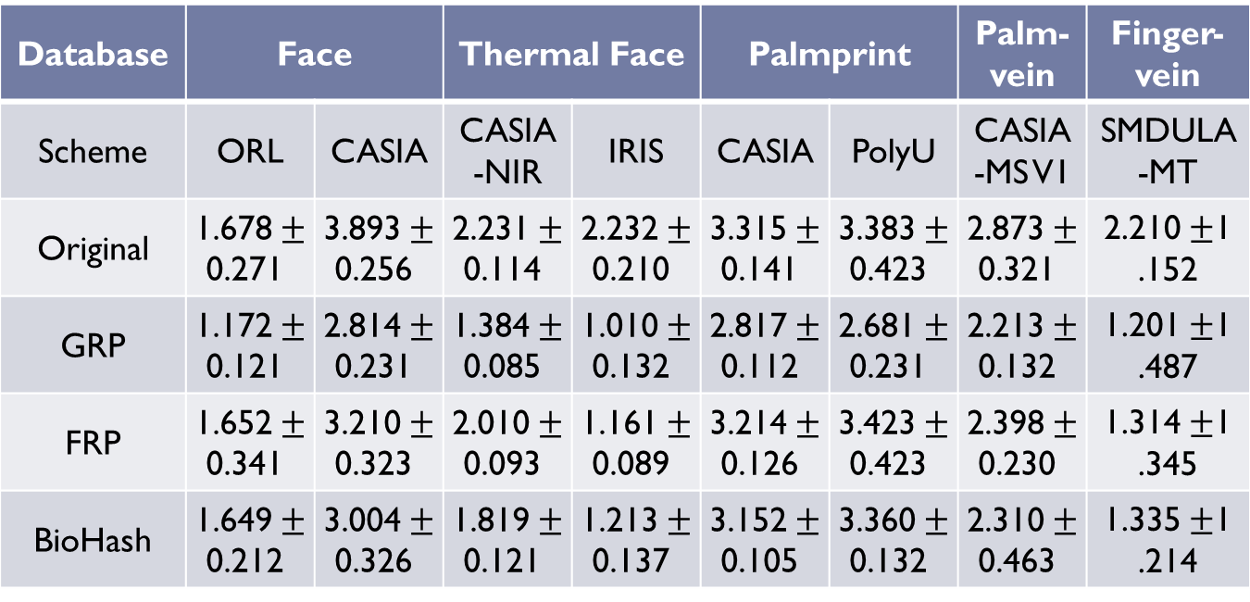
Matching Performance- (DI) at 95% significance level
Database | Face |  | Thermal Face |  | Palmprint |  | Palm-vein | Finger-vein
Scheme | ORL | CASIA | CASIA-NIR | IRIS | CASIA | PolyU | CASIA-MS V1 | SMDULA-MT
Original | $\text{1.678}±$0.271 | $\text{3.893}±$0.256 | $\text{2.231}±$0.114 | $\text{2.232}±$0.210 | $\text{3.315}±$0.141 | $\text{3.383}±$0.423 | $\text{2.873}±$0.321 | $\text{2.210}±$1.152
GRP | $\text{1.172}±$0.121 | $\text{2.814}±$0.231 | $\text{1.384}±$0.085 | $\text{1.010}±$0.132 | $\text{2.817}±$0.112 | $\text{2.681}±$0.231 | $\text{2.213}±$0.132 | $\text{1.201}±$1.487
FRP | $\text{1.652}±$0.341 | $\text{3.210}±$0.323 | $\text{2.010}±$0.093 | $\text{1.161}±$0.089 | $\text{3.214}±$0.126 | $\text{3.423}±$0.423 | $\text{2.398}±$0.230 | $\text{1.314}±$1.345
BioHash | $\text{1.649}±$0.212 | $\text{3.004}±$0.326 | $\text{1.819}±$0.121 | $\text{1.213}±$0.137 | $\text{3.152}±$0.105 | $\text{3.360}±$0.132 | $\text{2.310}±$0.463 | $\text{1.335}±$1.214

Slide 20
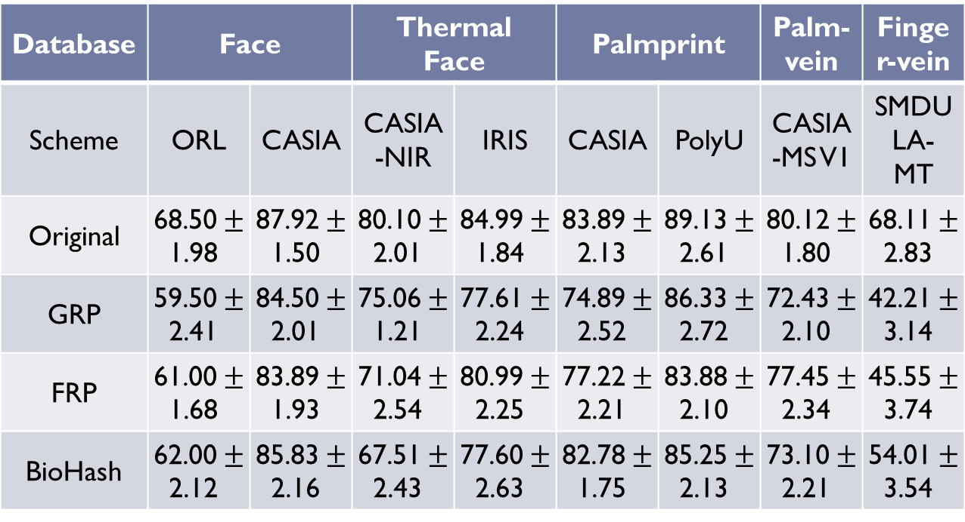
Matching Performance- (RI%) at 95% significance level
Database | Face |  | Thermal Face |  | Palmprint |  | Palm-vein | Finger-vein
Scheme | ORL | CASIA | CASIA-NIR | IRIS | CASIA | PolyU | CASIA-MS V1 | SMDULA-MT
Original | $\text{68.50}±$1.98 | $\text{87.92}±$1.50 | $\text{80.10}±$2.01 | $\text{84.99}±$1.84 | $\text{83.89}±$2.13 | $\text{89.13}±$2.61 | $\text{80.12}±$1.80 | $\text{68.11}±$2.83
GRP | $\text{59.50}±$2.41 | $\text{84.50}±$2.01 | $\text{75.06}±$1.21 | $\text{77.61}±$2.24 | $\text{74.89}±$2.52 | $\text{86.33}±$2.72 | $\text{72.43}±$2.10 | $\text{42.21}±$3.14
FRP | $\text{61.00}±$1.68 | $\text{83.89}±$1.93 | $\text{71.04}±$2.54 | $\text{80.99}±$2.25 | $\text{77.22}±$2.21 | $\text{83.88}±$2.10 | $\text{77.45}±$2.34 | $\text{45.55}±$3.74
BioHash | $\text{62.00}±$2.12 | $\text{85.83}±$2.16 | $\text{67.51}±$2.43 | $\text{77.60}±$2.63 | $\text{82.78}±$1.75 | $\text{85.25}±$2.13 | $\text{73.10}±$2.21 | $\text{54.01}±$3.54

Slide 21
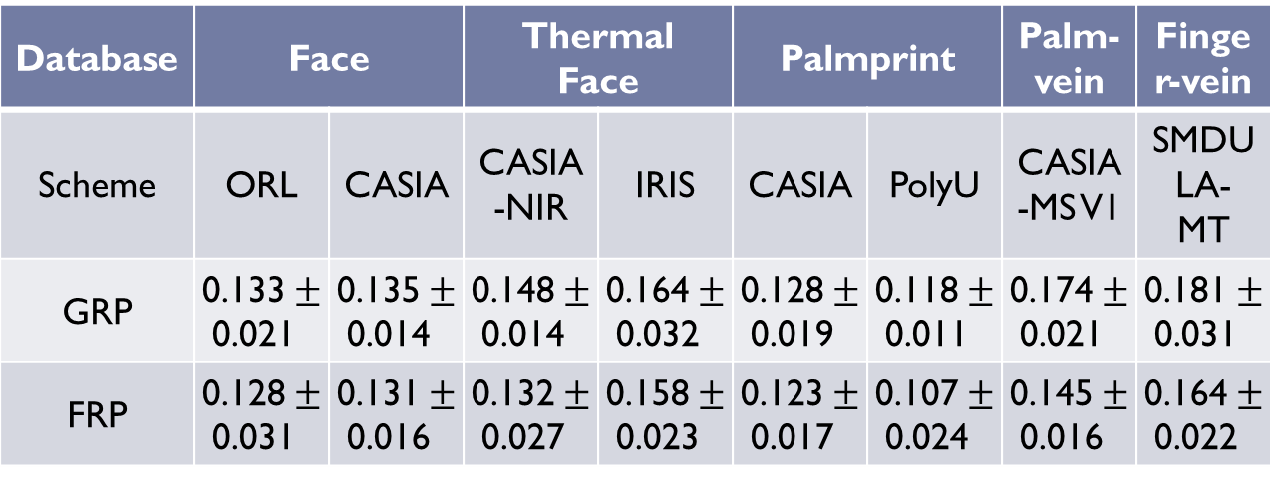
Changeability Performance- (CI) at 95% significance level
Database | Face |  | Thermal Face |  | Palmprint |  | Palm-vein | Finger-vein
Scheme | ORL | CASIA | CASIA-NIR | IRIS | CASIA | PolyU | CASIA-MS V1 | SMDULA-MT
GRP | $\text{0.133}±$0.021 | $\text{0.135}±$0.014 | $\text{0.148}±$0.014 | $\text{0.164}±$0.032 | $\text{0.128}±$0.019 | $\text{0.118}±$0.011 | $\text{0.174}±$0.021 | $\text{0.181}±$0.031
FRP | $\text{0.128}±$0.031 | $\text{0.131}±$0.016 | $\text{0.132}±$0.027 | $\text{0.158}±$0.023 | $\text{0.123}±$0.017 | $\text{0.107}±$0.024 | $\text{0.145}±$0.016 | $\text{0.164}±$0.022

Slide 22
Performance Notes
Matching Performance (worst-case):
GRP is slightly degraded but comparable to original.
FRP better than GRP and closer to original.
BioHash performs better than GRP.
FRP performance better or comparable to BioHash.
Performance for thermal modalities is low and degrades more for all the transformation approaches.
Matching Performance (best-case):
Nearly 0% EER, high DI (>16), and nearly 100% RI.
Changeability Performance:
CI is low for both the approaches.
Cross-matching EER is high, nearly 50%, indicating no-match.

Slide 23
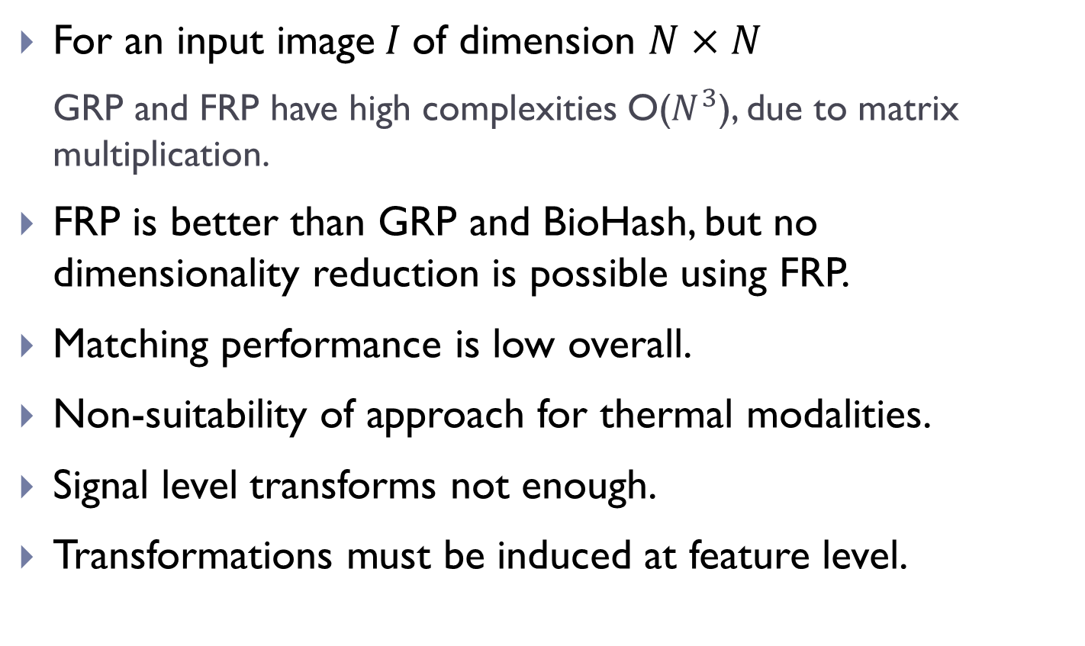
Observations
For an input image$I$of dimension $N×N$
GRP and FRP have high complexities O($N^{3}$), due to matrix multiplication.
FRP is better than GRP and BioHash, but no dimensionality reduction is possible using FRP.
Matching performance is low overall.
Non-suitability of approach for thermal modalities.
Signal level transforms not enough.
Transformations must be induced at feature level.

Slide 24
2. XOR based Template Transformation
Motivation: A new salting approach competitive to RP with less complexity

Slide 25
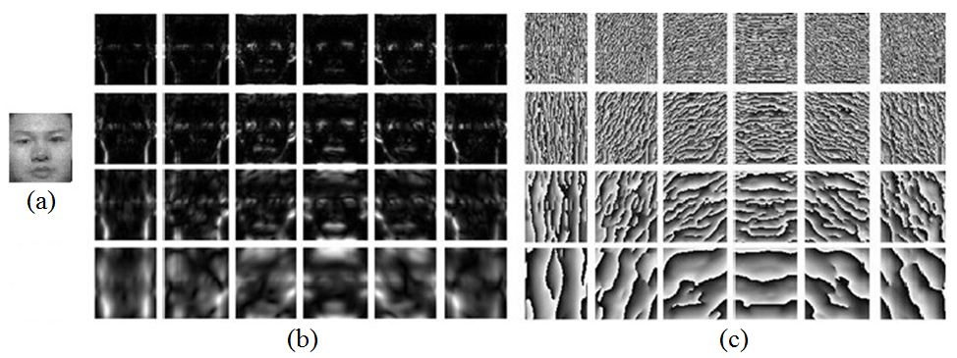
Log-Gabor Filters
Input image Feature extraction Feature transformation.
Feature extraction
Log-Gabor filters at multiple scales (4) and orientations(6).
Significant increase in dimensionality of feature (24 times).
Fig. 2 Sample images for log-Gabor filtering (a) Original image, (b)-(c) Log-Gabor magnitude and phase patterns at n=4 scales and m=6 orientations.

Slide 26
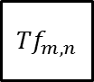
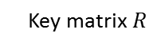
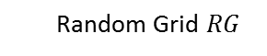
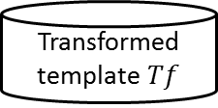
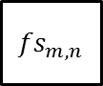
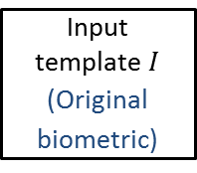
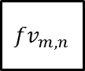
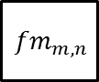
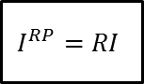

Proposed Approach
Multi-level Distortions using Random Projections and XOR based Salting
Random Projection is used to reduce dimensionality by 50% at signal level
De-sampling reduces dimensionality by 50% at feature level
Input template $I$
(Original biometric)
Random
Projection
$$I^{RP}=RI$$
log-Gabor
filtering
$${fv}_{m,n}^{}$$
$${fm}_{m,n}^{}$$
De-sampling
$${Tf}_{m,n}^{}$$
Median filtering
user- specific token
Key matrix $R$
Random Grid $RG$
XOR
$${fs}_{m,n}^{}$$
Transformed template $Tf$
Input user-specific token $R \&$ $RG$
Signal level distortion
Feature level distortion
(Pseudo-biometric)
H. Kaur, P. Khanna, “Cancelable features using log-Gabor filters for biometric authentication,” Multimedia Tools and Applications, vol. 76, no. 4, pp. 4673--4694, 2017.

Slide 27
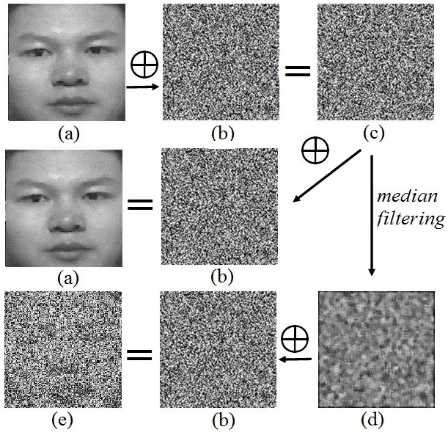
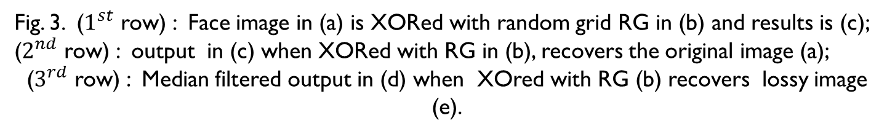
Non-invertibility using Median Filtering
Fig. 3. ($1^{st}$ row) : Face image in (a) is XORed with random grid RG in (b) and results is (c); ($2^{nd}$ row) : output in (c) when XORed with RG in (b), recovers the original image (a);
($3^{rd}$ row) : Median filtered output in (d) when XOred with RG (b) recovers lossy image (e).

Slide 28
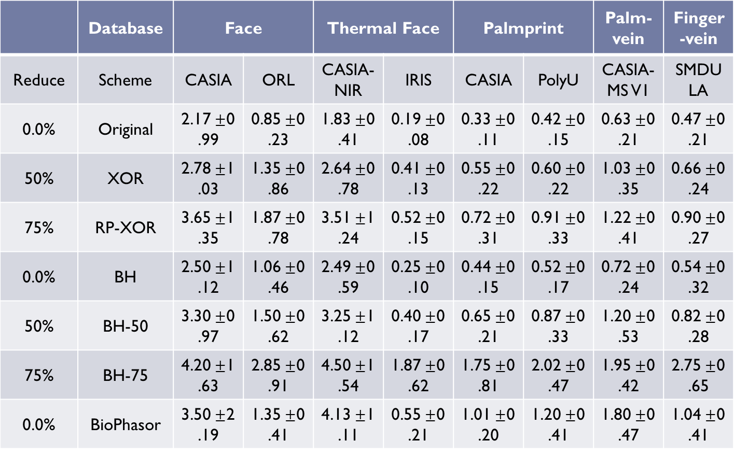
Matching Performance- (EER%) at 95% significance level
 | Database | Face |  | Thermal Face |  | Palmprint |  | Palm-vein | Finger-vein
Reduce | Scheme | CASIA | ORL | CASIA-NIR | IRIS | CASIA | PolyU | CASIA-MS V1 | SMDULA
0.0% | Original | $\text{2.17}±$0.99 | $\text{0.85}±$0.23 | $\text{1.83}±$0.41 | $\text{0.19}±$0.08 | $\text{0.33}±$0.11 | $\text{0.42}±$0.15 | $\text{0.63}±$0.21 | $\text{0.47}±$0.21
50% | XOR | $\text{2.78}±$1.03 | $\text{1.35}±$0.86 | $\text{2.64}±$0.78 | $\text{0.41}±$0.13 | $\text{0.55}±$0.22 | $\text{0.60}±$0.22 | $\text{1.03}±$0.35 | $\text{0.66}±$0.24
75% | RP-XOR | $\text{3.65}±$1.35 | $\text{1.87}±$0.78 | $\text{3.51}±$1.24 | $\text{0.52}±$0.15 | $\text{0.72}±$0.31 | $\text{0.91}±$0.33 | $\text{1.22}±$0.41 | $\text{0.90}±$0.27
0.0% | BH | $\text{2.50}±$1.12 | $\text{1.06}±$0.46 | $\text{2.49}±$0.59 | $\text{0.25}±$0.10 | $\text{0.44}±$0.15 | $\text{0.52}±$0.17 | $\text{0.72}±$0.24 | $\text{0.54}±$0.32
50% | BH-50 | $\text{3.30}±$0.97 | $\text{1.50}±$0.62 | $\text{3.25}±$1.12 | $\text{0.40}±$0.17 | $\text{0.65}±$0.21 | $\text{0.87}±$0.33 | $\text{1.20}±$0.53 | $\text{0.82}±$0.28
75% | BH-75 | $\text{4.20}±$1.63 | $\text{2.85}±$0.91 | $\text{4.50}±$1.54 | $\text{1.87}±$0.62 | $\text{1.75}±$0.81 | $\text{2.02}±$0.47 | $\text{1.95}±$0.42 | $\text{2.75}±$0.65
0.0% | BioPhasor | $\text{3.50}±$2.19 | $\text{1.35}±$0.41 | $\text{4.13}±$1.11 | $\text{0.55}±$0.21 | $\text{1.01}±$0.20 | $\text{1.20}±$0.41 | $\text{1.80}±$0.47 | $\text{1.04}±$0.41

Slide 29
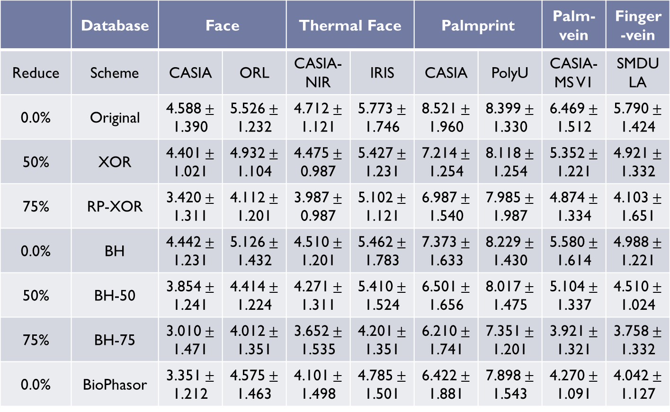
Matching Performance- (DI) at 95% significance level
 | Database | Face |  | Thermal Face |  | Palmprint |  | Palm-vein | Finger-vein
Reduce | Scheme | CASIA | ORL | CASIA-NIR | IRIS | CASIA | PolyU | CASIA-MS V1 | SMDULA
0.0% | Original | $\text{4.588}±$1.390 | $\text{5.526}±$1.232 | $\text{4.712}±$1.121 | $\text{5.773}±$1.746 | $\text{8.521}±$1.960 | $\text{8.399}±$1.330 | $\text{6.469}±$1.512 | $\text{5.790}±$1.424
50% | XOR | $\text{4.401}±$1.021 | $\text{4.932}±$1.104 | $\text{4.475}±$0.987 | $\text{5.427}±$1.231 | $\text{7.214}±$1.254 | $\text{8.118}±$1.254 | $\text{5.352}±$1.221 | $\text{4.921}±$1.332
75% | RP-XOR | $\text{3.420}±$1.311 | $\text{4.112}±$1.201 | $\text{3.987}±$0.987 | $\text{5.102}±$1.121 | $\text{6.987}±$1.540 | $\text{7.985}±$1.987 | $\text{4.874}±$1.334 | $\text{4.103}±$1.651
0.0% | BH | $\text{4.442}±$1.231 | $\text{5.126}±$1.432 | $\text{4.510}±$1.201 | $\text{5.462}±$1.783 | $\text{7.373}±$1.633 | $\text{8.229}±$1.430 | $\text{5.580}±$1.614 | $\text{4.988}±$1.221
50% | BH-50 | $\text{3.854}±$1.241 | $\text{4.414}±$1.224 | $\text{4.271}±$1.311 | $\text{5.410}±$1.524 | $\text{6.501}±$1.656 | $\text{8.017}±$1.475 | $\text{5.104}±$1.337 | $\text{4.510}±$1.024
75% | BH-75 | $\text{3.010}±$1.471 | $\text{4.012}±$1.351 | $\text{3.652}±$1.535 | $\text{4.201}±$1.351 | $\text{6.210}±$1.741 | $\text{7.351}±$1.201 | $\text{3.921}±$1.321 | $\text{3.758}±$1.332
0.0% | BioPhasor | $\text{3.351}±$1.212 | $\text{4.575}±$1.463 | $\text{4.101}±$1.498 | $\text{4.785}±$1.501 | $\text{6.422}±$1.881 | $\text{7.898}±$1.543 | $\text{4.270}±$1.091 | $\text{4.042}±$1.127

Slide 30
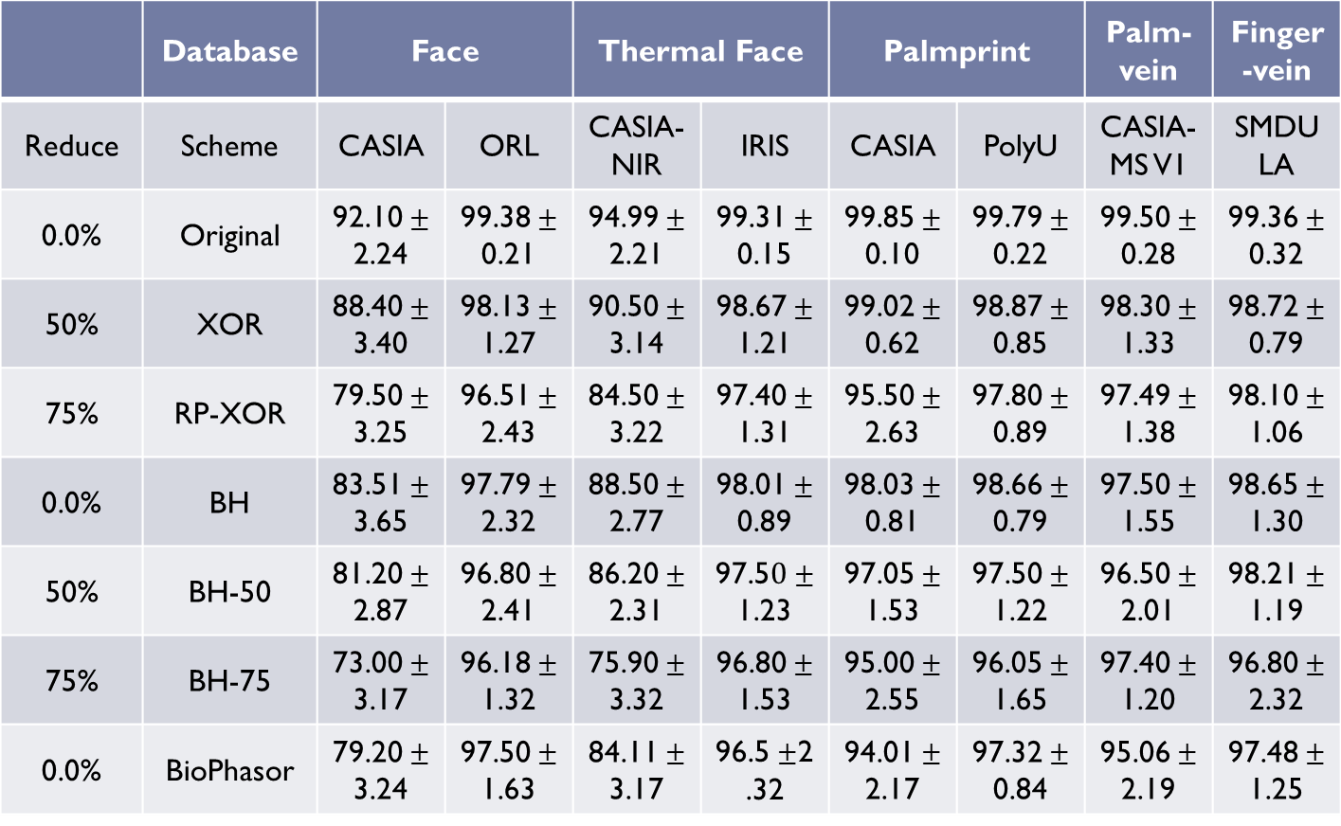
Matching Performance- (RI%) at 95% significance level
 | Database | Face |  | Thermal Face |  | Palmprint |  | Palm-vein | Finger-vein
Reduce | Scheme | CASIA | ORL | CASIA-NIR | IRIS | CASIA | PolyU | CASIA-MS V1 | SMDULA
0.0% | Original | $\text{92.10}±$2.24 | $\text{99.38}±$0.21 | $\text{94.99}±$2.21 | $\text{99.31}±$0.15 | $\text{99.85}±$0.10 | $\text{99.79}±$0.22 | $\text{99.50}±$0.28 | $\text{99.36}±$0.32
50% | XOR | $\text{88.40}±$3.40 | $\text{98.13}±$1.27 | $\text{90.50}±$3.14 | $\text{98.67}±$1.21 | $\text{99.02}±$0.62 | $\text{98.87}±$0.85 | $\text{98.30}±$1.33 | $\text{98.72}±$0.79
75% | RP-XOR | $\text{79.50}±$3.25 | $\text{96.51}±$2.43 | $\text{84.50}±$3.22 | $\text{97.40}±$1.31 | $\text{95.50}±$2.63 | $\text{97.80}±$0.89 | $\text{97.49}±$1.38 | $\text{98.10}±$1.06
0.0% | BH | $\text{83.51}±$3.65 | $\text{97.79}±$2.32 | $\text{88.50}±$2.77 | $\text{98.01}±$0.89 | $\text{98.03}±$0.81 | $\text{98.66}±$0.79 | $\text{97.50}±$1.55 | $\text{98.65}±$1.30
50% | BH-50 | $\text{81.20}±$2.87 | $\text{96.80}±$2.41 | $\text{86.20}±$2.31 | $\text{97.5}0±$1.23 | $\text{97.05}±$1.53 | $\text{97.50}±$1.22 | $\text{96.50}±$2.01 | $\text{98.21}±$1.19
75% | BH-75 | $\text{73.00}±$3.17 | $\text{96.18}±$1.32 | $\text{75.90}±$3.32 | $\text{96.80}±$1.53 | $\text{95.00}±$2.55 | $\text{96.05}±$1.65 | $\text{97.40}±$1.20 | $\text{96.80}±$2.32
0.0% | BioPhasor | $\text{79.20}±$3.24 | $\text{97.50}±$1.63 | $\text{84.11}±$3.17 | $\text{96.5}±$2.32 | $\text{94.01}±$2.17 | $\text{97.32}±$0.84 | $\text{95.06}±$2.19 | $\text{97.48}±$1.25

Slide 31
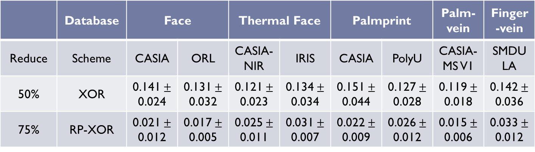
Matching Performance- (CI%) at 95% significance level
 | Database | Face |  | Thermal Face |  | Palmprint |  | Palm-vein | Finger-vein
Reduce | Scheme | CASIA | ORL | CASIA-NIR | IRIS | CASIA | PolyU | CASIA-MS V1 | SMDULA
50% | XOR | $\text{0.141}±$0.024 | $\text{0.131}±$0.032 | $\text{0.121}±$0.023 | $\text{0.134}±$0.034 | $\text{0.151}±$0.044 | $\text{0.127}±$0.028 | $\text{0.119}±$0.018 | $\text{0.142}±$0.036
75% | RP-XOR | $\text{0.021}±$0.012 | $\text{0.017}±$0.005 | $\text{0.025}±$0.011 | $\text{0.031}±$0.007 | $\text{0.022}±$0.009 | $\text{0.026}±$0.012 | $\text{0.015}±$0.006 | $\text{0.033}±$0.012

Slide 32
Performance Notes:
Dimensionality Reduction
Single-level (XOR): 50%, Multi-level (RP-XOR): 75%
Matching Performance (worst-case):
XOR at 50% reduction - slightly less, comparable to original .
XOR - better than RP-XOR and BioPhasor.
XOR at 50% reduction - less than BH at no reduction.
XOR at 50% reduction - better than BH-50 at 50% reduction.
RP-XOR at 75% reduction - comparable to BH-50, BioPhasor, and better than BH-75.
Matching Performance (best-case):
Nearly 0% EER, high DI (>25) and, nearly 100% RI.
Changeability Performance:
CI – low, Cross-matching EER is high, nearly 50%, indicating no-match.

Slide 33
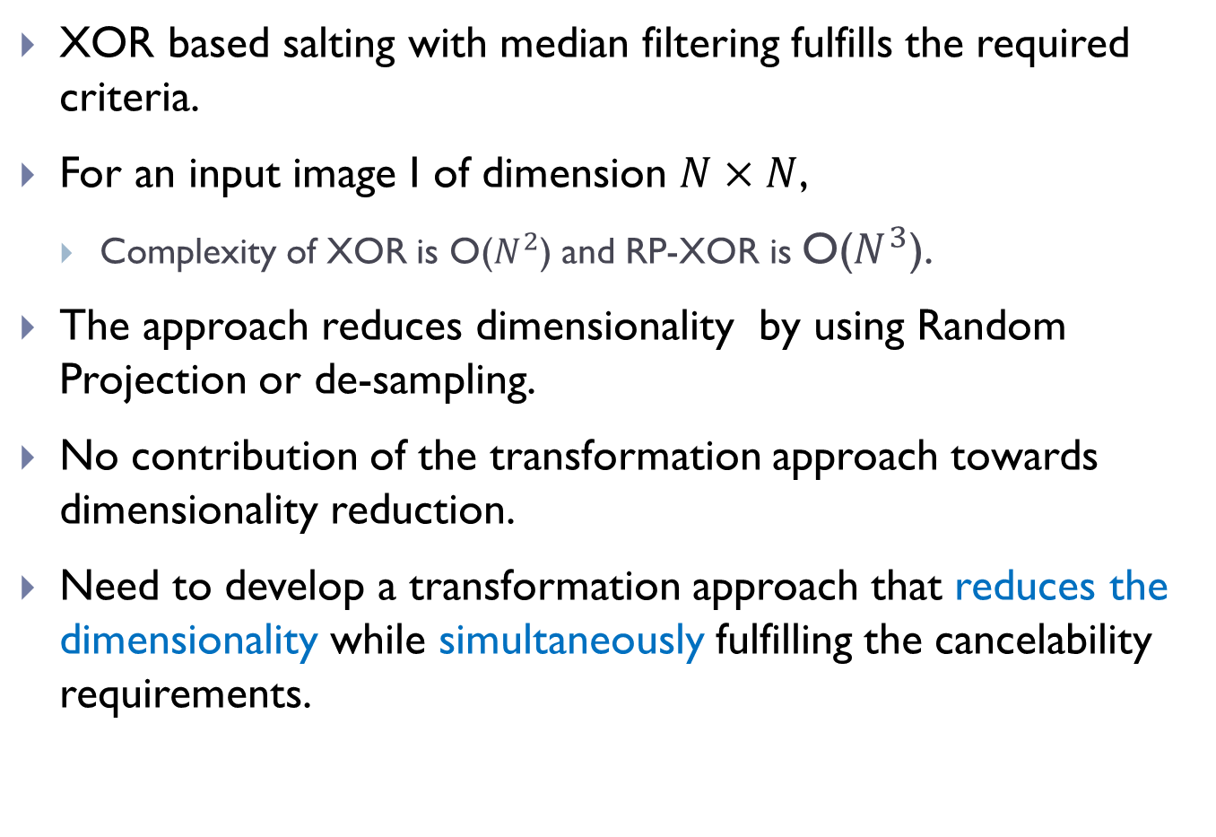
Observations
XOR based salting with median filtering fulfills the required criteria.
For an input image I of dimension $N×N$,
Complexity of XOR is O($N^{2}$) and RP-XOR is O($N^{3}$).
The approach reduces dimensionality by using Random Projection or de-sampling.
No contribution of the transformation approach towards dimensionality reduction.
Need to develop a transformation approach that reduces the dimensionality while simultaneously fulfilling the cancelability requirements.

Slide 34
3. Random Distance Method
Motivation- Reduce Dimensionality without RP

Slide 35
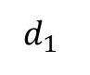
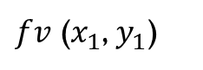







Proposed Concept
Random Distance Method: Let a feature vector $fv$be represented as a point ($x_{i},y_{i}$) in a Cartesian coordinate system. Then, instead of using original feature $fv,$its distance from some random point ($x_{0},y_{0}$) can be used for matching purposes.
Let $fv\text{ (}x_{1}\text{, }y_{1}\text{)}$, $fv$ ($x_{2}$, $y_{2}$) belong to same user and $fv$ ($x_{3}$, $y_{3}$) belong to different user.
Let random point be $rp$($x_{0}$, $y_{0}$).
Then it is proved that the distances $d_{1}$ , $d_{2}$ and $d_{3}$ are transformed features which carry the discriminative information of original features.
$fv$ ($x_{3}$, $y_{3}$)
$$d_{3}$$
$$d_{2}$$
$fv$ ($x_{2}$, $y_{2}$)
$rp$($x_{0}$, $y_{0}$)
$$d_{1}$$
$fv$ ($x_{1}$, $y_{1}$)

Slide 36















Proposed Approach
$$X_{1}$$
Dimensionality reduction by half= 50%
Image template
feature extraction
feature salting
Compute distance
Median filtering
$$Y_{1}$$
$$fv$$
$$fs$$
Transformed template $Tf$
$$(X_{0},Y_{0})$$
$$(X_{1},Y_{1})$$
$$D$$
$$X_{0}$$
Random key generation
$$d$$
$fs$ ($x_{1}$, $y_{1}$)
$$Y_{0}$$
$$K$$
$rp$($x_{0}$, $y_{0}$)

Slide 37

Non-invertibility using Median Filtering
Case(1)
Case(2)
Fig. 4 (a) Original feature, (b) Key $K$, (c) distance matrix $D$, (e) filtered distance matrix$Tf$, (e) and (f) recovered templates in case(1), and (g) and (h) recovered templates in case(2).

Slide 38

Matching Performance- (EER%) at 95% significance level
 | Database | Face |  | Thermal Face |  | Palmprint |  | Palm-vein | Finger-vein
Reduce | Scheme | CASIA | ORL | CASIA-NIR | IRIS | CASIA | PolyU | CASIA-MS V1 | SMDULA
0.0% | Original | $\text{2.17}±$0.99 | $\text{0.85}±$0.23 | $\text{1.83}±$0.41 | $\text{0.19}±$0.08 | $\text{0.33}±$0.11 | $\text{0.42}±$0.15 | $\text{0.63}±$0.21 | $\text{0.47}±$0.21
50% | RDM | $\text{2.65}±$1.05 | $\text{1.18}±$0.42 | $\text{2.54}±$0.39 | $\text{0.29}±$0.12 | $\text{0.46}±$0.23 | $\text{0.56}±$0.21 | $\text{0.83}±$0.41 | $\text{0.59}±$0.27
0.0% | BH | $\text{2.50}±$1.12 | $\text{1.06}±$0.46 | $\text{2.49}±$0.59 | $\text{0.25}±$0.10 | $\text{0.44}±$0.15 | $\text{0.52}±$0.17 | $\text{0.72}±$0.24 | $\text{0.54}±$0.32
50% | BH-50 | $\text{3.30}±$0.97 | $\text{1.50}±$0.62 | $\text{3.25}±$1.12 | $\text{0.40}±$0.17 | $\text{0.65}±$0.21 | $\text{0.87}±$0.33 | $\text{1.20}±$0.53 | $\text{0.82}±$0.28
75% | BH-75 | $\text{4.20}±$1.63 | $\text{2.85}±$0.91 | $\text{4.50}±$1.54 | $\text{1.87}±$0.62 | $\text{1.75}±$0.81 | $\text{2.02}±$0.47 | $\text{1.95}±$0.42 | $\text{2.75}±$0.65
0.0% | BioPhasor | $\text{3.50}±$2.19 | $\text{1.35}±$0.41 | $\text{4.13}±$1.11 | $\text{0.55}±$0.21 | $\text{1.01}±$0.20 | $\text{1.20}±$0.41 | $\text{1.80}±$0.47 | $\text{1.04}±$0.41

Slide 39

Matching Performance- (DI) at 95% significance level
 | Database | Face |  | Thermal Face |  | Palmprint |  | Palm-vein | Finger-vein
Reduce | Scheme | CASIA | ORL | CASIA-NIR | IRIS | CASIA | PolyU | CASIA-MS V1 | SMDULA
0.0% | Original | $\text{4.588}±$1.390 | $\text{5.526}±$1.232 | $\text{4.712}±$1.121 | $\text{5.773}±$1.746 | $\text{8.521}±$1.960 | $\text{8.399}±$1.330 | $\text{6.469}±$1.512 | $\text{5.790}±$1.424
50% | RDM | $\text{4.421}±$1.041 | $\text{5.107}±$1.211 | $\text{4.502}±$1.012 | $\text{5.459}±$1.421 | $\text{7.341}±$1.411 | $\text{8.210}±$1.210 | $\text{5.422}±$1.212 | $\text{4.950}±$1.321
0.0% | BH | $\text{4.442}±$1.231 | $\text{5.126}±$1.432 | $\text{4.510}±$1.201 | $\text{5.462}±$1.783 | $\text{7.373}±$1.633 | $\text{8.229}±$1.430 | $\text{5.580}±$1.614 | $\text{4.988}±$1.221
50% | BH-50 | $\text{3.854}±$1.241 | $\text{4.414}±$1.224 | $\text{4.271}±$1.311 | $\text{5.410}±$1.524 | $\text{6.501}±$1.656 | $\text{8.017}±$1.475 | $\text{5.104}±$1.337 | $\text{4.510}±$1.024
75% | BH-75 | $\text{3.010}±$1.471 | $\text{4.012}±$1.351 | $\text{3.652}±$1.535 | $\text{4.201}±$1.351 | $\text{6.210}±$1.741 | $\text{7.351}±$1.201 | $\text{3.921}±$1.321 | $\text{3.758}±$1.332
0.0% | BioPhasor | $\text{3.351}±$1.212 | $\text{4.575}±$1.463 | $\text{4.101}±$1.498 | $\text{4.785}±$1.501 | $\text{6.422}±$1.881 | $\text{7.898}±$1.543 | $\text{4.270}±$1.091 | $\text{4.042}±$1.127

Slide 40

Matching Performance- (RI%) at 95% significance level
 | Database | Face |  | Thermal Face |  | Palmprint |  | Palm-vein | Finger-vein
Reduce | Scheme | CASIA | ORL | CASIA-NIR | IRIS | CASIA | PolyU | CASIA-MS V1 | SMDULA
0.0% | Original | $\text{92.10}±$2.24 | $\text{99.38}±$0.21 | $\text{94.99}±$2.21 | $\text{99.31}±$0.15 | $\text{99.85}±$0.10 | $\text{99.79}±$0.22 | $\text{99.50}±$0.28 | $\text{99.36}±$0.32
50% | RDM | $\text{88.82}±$3.14 | $\text{98.50}±$1.18 | $\text{92.47}±$2.64 | $\text{99.14}±$0.31 | $\text{98.03}±$1.27 | $\text{99.34}±$0.25 | $\text{98.63}±$1.42 | $\text{99.11}±$0.34
0.0% | BH | $\text{83.51}±$3.65 | $\text{97.79}±$2.32 | $\text{88.50}±$2.77 | $\text{98.01}±$0.89 | $\text{98.03}±$0.81 | $\text{98.66}±$0.79 | $\text{97.50}±$1.55 | $\text{98.65}±$1.30
50% | BH-50 | $\text{81.20}±$2.87 | $\text{96.80}±$2.41 | $\text{86.20}±$2.31 | $\text{97.5}0±$1.23 | $\text{97.05}±$1.53 | $\text{97.50}±$1.22 | $\text{96.50}±$2.01 | $\text{98.21}±$1.19
75% | BH-75 | $\text{73.00}±$3.17 | $\text{96.18}±$1.32 | $\text{75.90}±$3.32 | $\text{96.80}±$1.53 | $\text{95.00}±$2.55 | $\text{96.05}±$1.65 | $\text{97.40}±$1.20 | $\text{96.80}±$2.32
0.0% | BioPhasor | $\text{79.20}±$3.24 | $\text{97.50}±$1.63 | $\text{84.11}±$3.17 | $\text{96.5}±$2.32 | $\text{94.01}±$2.17 | $\text{97.32}±$0.84 | $\text{95.06}±$2.19 | $\text{97.48}±$1.25

Slide 41

Matching Performance- (CI%) at 95% significance level
Database | Face |  | Thermal Face |  | Palmprint |  | Palm-vein | Finger-vein
Scheme | CASIA | ORL | CASIA-NIR | IRIS | CASIA | PolyU | CASIA-MS V1 | SMDULA
RDM | $\text{0.161}±$0.032 | $\text{0.125}±$0.042 | $\text{0.113}±$0.035 | $\text{0.142}±$0.029 | $\text{0.121}±$0.051 | $\text{0.102}±$0.028 | $\text{0.124}±$0.036 | $\text{0.137}±$0.047
RDMS | $\text{0.032}±$0.010 | $\text{0.029}±$0.007 | $\text{0.035}±$0.015 | $\text{0.018}±$0.005 | $\text{0.027}±$0.010 | $\text{0.031}±$0.013 | $\text{0.019}±$0.009 | $\text{0.028}±$0.011

Slide 42
Performance Notes
Dimensionality Reduction
RDM reduces by 50%.
Matching Performance (worst-case):
RDM at 50% reduction - slightly less, comparable to original .
RDM at 50% reduction - better than XOR at 50% reduction and slightly less than BH at no reduction.
RDM at 50% reduction - better than BH-50 at 50% reduction.
RDM at 50% reduction - better than BioPhasor at no reduction.
Matching Performance (best-case):
Nearly 0% EER, high DI (>25) and, nearly 100% RI.
Changeability Performance:
CI is low for the approach.
Cross-matching EER is high, nearly 50%, indicating no-match.

Slide 43

Observations
RDM based transform and reduces dimensionality by 50%.
Median filtering is required to achieve non-invertibility the required criteria.
For an input image I of dimension $N×N$,
Complexity of RDM is O($N^{2}$)
Euclidean distances and median filtering operations are still costly.
Reduction is only upto 50%, less than RP-XOR (75%)
Need to develop a transformation approach that reduces the dimensionality, reduces complexity, and non-invertible while simultaneously fulfilling the cancelability requirements.

Slide 44
4. Random Slope Method
Motivation- Further reduction in Dimensionality, non-invertible without median filtering

Slide 45










Proposed Concept
Random Slope Concept: Let $fv$ be represented by as a point ($x_{i},y_{i}$) in a Cartesian coordinate system. Then, instead of using biometric feature vectors, the slope and intercepts of the line joining the feature point with some random point ($x_{0},y_{0}$) can be used for matching purposes.
$fv$ ($x_{3}$, $y_{3}$)
Let $fv\text{ (}x_{1}\text{, }y_{1}\text{)}$, $fv$ ($x_{2}$, $y_{2}$) belong to same user and $fv$ ($x_{3}$, $y_{3}$) belong to different user.
Let random point be $rp$($x_{0}$, $y_{0}$).
Then it is proved that the slopes and intercepts $m_{1}{,c}_{1};$ $m_{2}{,c}_{2};$ and $m_{3}{,c}_{3};$ also carry the discriminative information of original features.
$rp$($x_{0}$, $y_{0}$)
$c_{1}$, $c_{2}$
$$m_{2}$$
$$m_{1}$$
$fv$ ($x_{2}$, $y_{2}$)
$m_{3}$, $c_{3}$
$fv$ ($x_{1}$, $y_{1}$)

Slide 46

















Proposed Approach-1/2 (RS-V1)
Dimensionality reduction by half= 50%
$$X_{1}$$
Image template
feature extraction
feature salting
Compute slope and intercept
Normalized and added
$$Y_{1}$$
$$fv$$
$$fs$$
$$(X_{0},Y_{0})$$
$$(X_{1},Y_{1})$$
$$M$$
Transformed template $Tf$
$$C$$
$$X_{0}$$
Random key generation
$fv$ ($x_{1}$, $y_{1}$)
$$R$$
$$intercept c$$
$$Y_{0}$$
($x_{0}$, $y_{0}$)
$$K$$
$$m=tan⁡(θ)$$

Slide 47


















Proposed Approach- 2/2 (RS-V2)
Dimensionality reduction by ¼ = 75%
$$X_{1}$$
$$X_{2}$$
Sensor
feature extraction
feature salting
Calculate angle between two lines
$$Y_{1}$$
$$Y_{2}$$
$$M_{1}$$
$$M_{2}$$
Transformed template $Tf$
$$fv$$
$$fs$$
$$X_{0}$$
$tan⁡(θ)$=$\frac{m_{1}m_{2}}{1+m_{1}m_{2}}$
$$l_{2}$$
Random key generation
$fv$ ($x_{2}$, $y_{2}$)
$$K$$
$fv$ ($x_{1}$, $y_{1}$)
$$Y_{0}$$
$$l_{1}$$
$M_{1}$=slope of line $l_{1}$ passing through ($X_{1}$, $Y_{1}$) and ($X_{0}$, $Y_{0}$),
$M_{2}$=slope of line $l_{2}$ passing through ($X_{2}$, $Y_{2}$) and ($X_{0}$, $Y_{0}$)
($x_{0}$, $y_{0}$)

Slide 48

Matching Performance- (EER%) at 95% significance level
 | Database | Face |  | Thermal Face |  | Palmprint |  | Palm-vein | Finger-vein
Reduce | Scheme | CASIA | ORL | CASIA-NIR | IRIS | CASIA | PolyU | CASIA-MS V1 | SMDULA
0.0% | Original | $\text{2.17}±$0.99 | $\text{0.85}±$0.23 | $\text{1.83}±$0.41 | $\text{0.19}±$0.08 | $\text{0.33}±$0.11 | $\text{0.42}±$0.15 | $\text{0.63}±$0.21 | $\text{0.47}±$0.21
50% | RS-V1 | $\text{2.40}±$1.12 | $\text{0.99}±$0.46 | $\text{2.21}±$0.59 | $\text{0.22}±$0.10 | $\text{0.42}±$0.15 | $\text{0.48}±$0.17 | $\text{0.68}±$0.24 | $\text{0.51}±$0.32
75% | RS-V2 | $\text{3.08}±$2.11 | $\text{1.19}±$0.19 | $\text{2.80}±$0.82 | $\text{0.36}±$0.12 | $\text{0.52}±$0.29 | $\text{0.64}±$0.35 | $\text{1.11}±$.06 | $\text{0.68}±$0.26
0.0% | BH | $\text{2.50}±$1.12 | $\text{1.06}±$0.46 | $\text{2.49}±$0.59 | $\text{0.25}±$0.10 | $\text{0.44}±$0.15 | $\text{0.52}±$0.17 | $\text{0.72}±$0.24 | $\text{0.54}±$0.32
50% | BH-50 | $\text{3.30}±$0.97 | $\text{1.50}±$0.62 | $\text{3.25}±$1.12 | $\text{0.40}±$0.17 | $\text{0.65}±$0.21 | $\text{0.87}±$0.33 | $\text{1.20}±$0.53 | $\text{0.82}±$0.28
75% | BH-75 | $\text{4.20}±$1.63 | $\text{2.85}±$0.91 | $\text{4.50}±$1.54 | $\text{1.87}±$0.62 | $\text{1.75}±$0.81 | $\text{2.02}±$0.47 | $\text{1.95}±$0.42 | $\text{2.75}±$0.65
0.0% | BioPhasor | $\text{3.50}±$2.19 | $\text{1.35}±$0.41 | $\text{4.13}±$1.11 | $\text{0.55}±$0.21 | $\text{1.01}±$0.20 | $\text{1.20}±$0.41 | $\text{1.80}±$0.47 | $\text{1.04}±$0.41

Slide 49

Matching Performance- (DI) at 95% significance level
 | Database | Face |  | Thermal Face |  | Palmprint |  | Palm-vein | Finger-vein
Reduce | Scheme | CASIA | ORL | CASIA-NIR | IRIS | CASIA | PolyU | CASIA-MS V1 | SMDULA
0.0% | Original | $\text{4.588}±$1.390 | $\text{5.526}±$1.232 | $\text{4.712}±$1.121 | $\text{5.773}±$1.746 | $\text{8.521}±$1.960 | $\text{8.399}±$1.330 | $\text{6.469}±$1.512 | $\text{5.790}±$1.424
50% | RS-V1 | $\text{4.456}±$1.243 | $\text{5.282}±$1.321 | $\text{4.521}±$1.592 | $\text{5.462}±$1.942 | $\text{7.523}±$2.101 | $\text{8.259}±$1.321 | $\text{6.210}±$1.629 | $\text{5.398}±$1.533
75% | RS-V2 | $\text{4.408}±$1.321 | $\text{5.126}±$1.332 | $\text{4.510}±$0.998 | $\text{5.459}±$1.433 | $\text{7.348}±$1.747 | $\text{8.229}±$1.643 | $\text{5.580}±$1.345 | $\text{4.988}±$1.412
0.0% | BH | $\text{4.442}±$1.231 | $\text{5.126}±$1.432 | $\text{4.510}±$1.201 | $\text{5.462}±$1.783 | $\text{7.373}±$1.633 | $\text{8.229}±$1.430 | $\text{5.580}±$1.614 | $\text{4.988}±$1.221
50% | BH-50 | $\text{3.854}±$1.241 | $\text{4.414}±$1.224 | $\text{4.271}±$1.311 | $\text{5.410}±$1.524 | $\text{6.501}±$1.656 | $\text{8.017}±$1.475 | $\text{5.104}±$1.337 | $\text{4.510}±$1.024
75% | BH-75 | $\text{3.010}±$1.471 | $\text{4.012}±$1.351 | $\text{3.652}±$1.535 | $\text{4.201}±$1.351 | $\text{6.210}±$1.741 | $\text{7.351}±$1.201 | $\text{3.921}±$1.321 | $\text{3.758}±$1.332
0.0% | BioPhasor | $\text{3.351}±$1.212 | $\text{4.575}±$1.463 | $\text{4.101}±$1.498 | $\text{4.785}±$1.501 | $\text{6.422}±$1.881 | $\text{7.898}±$1.543 | $\text{4.270}±$1.091 | $\text{4.042}±$1.127

Slide 50

Matching Performance- (RI%) at 95% significance level
 | Database | Face |  | Thermal Face |  | Palmprint |  | Palm-vein | Finger-vein
Reduce | Scheme | CASIA | ORL | CASIA-NIR | IRIS | CASIA | PolyU | CASIA-MS V1 | SMDULA
0.0% | Original | $\text{92.10}±$2.24 | $\text{99.38}±$0.21 | $\text{94.99}±$2.21 | $\text{99.31}±$0.15 | $\text{99.85}±$0.10 | $\text{99.79}±$0.22 | $\text{99.50}±$0.28 | $\text{99.36}±$0.32
50% | RS-V1 | $\text{92.50}±$2.13 | $\text{98.85}±$0.49 | $\text{92.76}±$1.42 | $\text{99.76}±$0.11 | $\text{99.57}±$0.23 | $\text{99.89}±$0.07 | $\text{99.41}±$0.15 | $\text{99.40}±$0.12
75% | RS-V2 | $\text{91.27}±$2.39 | $\text{98.10}±$0.52 | $\text{91.15}±$2.13 | $\text{98.89}±$0.13 | $\text{99.45}±$0.34 | $\text{99.80}±$0.11 | $\text{98.20}±$0.21 | $\text{98.97}±$0.23
0.0% | BH | $\text{83.51}±$3.65 | $\text{97.79}±$2.32 | $\text{88.50}±$2.77 | $\text{98.01}±$0.89 | $\text{98.03}±$0.81 | $\text{98.66}±$0.79 | $\text{97.50}±$1.55 | $\text{98.65}±$1.30
50% | BH-50 | $\text{81.20}±$2.87 | $\text{96.80}±$2.41 | $\text{86.20}±$2.31 | $\text{97.5}0±$1.23 | $\text{97.05}±$1.53 | $\text{97.50}±$1.22 | $\text{96.50}±$2.01 | $\text{98.21}±$1.19
75% | BH-75 | $\text{73.00}±$3.17 | $\text{96.18}±$1.32 | $\text{75.90}±$3.32 | $\text{96.80}±$1.53 | $\text{95.00}±$2.55 | $\text{96.05}±$1.65 | $\text{97.40}±$1.20 | $\text{96.80}±$2.32
0.0% | BioPhasor | $\text{79.20}±$3.24 | $\text{97.50}±$1.63 | $\text{84.11}±$3.17 | $\text{96.5}±$2.32 | $\text{94.01}±$2.17 | $\text{97.32}±$0.84 | $\text{95.06}±$2.19 | $\text{97.48}±$1.25

Slide 51

Matching Performance- (CI%) at 95% significance level
 | Database | Face |  | Thermal Face |  | Palmprint |  | Palm-vein | Finger-vein
Reduce | Scheme | CASIA | ORL | CASIA-NIR | IRIS | CASIA | PolyU | CASIA-MS V1 | SMDULA
50% | RS-V1 | $\text{0.126}±$0.052 | $\text{0.095}±$0.061 | $\text{0.101}±$0.015 | $\text{0.111}±$0.032 | $\text{0.109}±$0.042 | $\text{0.112}±$0.048 | $\text{0.094}±$0.012 | $\text{0.112}±$0.047
75% | RS-V2 | $\text{0.132}±$0.032 | $\text{0.109}±$0.045 | $\text{0.095}±$0.032 | $\text{0.120}±$0.035 | $\text{0.115}±$0.041 | $\text{0.089}±$0.053 | $\text{0.117}±$0.032 | $\text{0.098}±$0.041

Slide 52
Performance Notes
Dimensionality Reduction
RS-V1 reduces by 50% and RS-V2 reduces by 75%.
Matching Performance (worst-case):
RS-V1 at 50% reduction - slightly less, comparable to original .
RS-V1 at 50% reduction - better than RDM and XOR at 50% and BH at no reduction.
RS-V2 at 75% reduction - comparable to XOR at 50% and better than BH-50 at 50% reduction.
RS-V1and RS-V2 - better than BioPhasor at no reduction.
Matching Performance (best-case):
Nearly 0% EER, high DI (>25) and, nearly 100% RI.
Changeability Performance:
CI – low, Cross-matching EER is high, nearly 50%, indicating no-match.

Slide 53

Observations
RS based transform and reduces dimensionality upto 75%.
Non-invertibility is also achieved.
For an input image $I$ of dimension $N×N$,
Complexity of RS-V1 and RS-V2 is O($N^{2}$)
Cancelability requirements are also met.
Dimensionality is fixed for the existing approaches.
A common approach will allows flexibility in dimensionality reduction is developed next.

Slide 54
5. Polynomial Transformation Method
Motivations- Flexible dimensionality reduction

Slide 55

Proposed Method
Polynomial Transformation Method:
A polynomial $f()$in variable $μ$ and degree $υ$is constructed such that its coefficients are salted biometric features.
It is then evaluated at some random point and the output value is taken as transformed quantity.
The evaluation matrix (consisting of random points) is provided to user in tokenized format.
The evaluated values are called ‘PolyCodes’
Apart from transformation, the approach offers dimensionality reduction by a factor $ρ=\left(\begin{matrix}μ+υ \\ υ\end{matrix}\right)$
Different transformation functions can be generated by varying $μ$ and degree $υ$.

Slide 56









PolyCodes-22
$$fv$$
$$fs$$
Sensor
feature extraction
salting
Construct polynomial
$$Tf\left(j\right)=f\left(X\left(j\right),Y\left(j\right)\right)=a_{1}^{j}+a_{2}^{j}x+a_{3}^{j}y$$
$$+a_{4}^{j}xy+a_{5}^{j}x^{2}+a_{6}^{j}y^{2}$$
Transformed template $Tf$
PolyCodes-22: bi-variable polynomial in degree 2, dimensionality reduction by 75%.

Slide 57

Proposed Approach-Illustration

Slide 58


Notes:
The approach is tested for different combinations of $μ$ and $υ$ and output for each is known as ‘PolyCodes- $μυ$’
No. of Variables | Degree | No. of terms $ρ$ | PolyCodes-$μυ$ | Dimension reduction
Uni-variable, $μ=1$ | $$υ=2$$ | $$3$$ | PolyCodes-$12$ | $$66.66\%$$
 | $$υ=3$$ | $$4$$ | PolyCodes-$13$ | $$75.00\%$$
Bi-variable, $μ=2$ | $$υ=2$$ | $$6$$ | PolyCodes-$22$ | $$83.33\%$$
 | $$υ=3$$ | $$10$$ | PolyCodes-$23$ | $$90.00\%$$
Tri-variable, $$μ=3$$ | $$υ=2$$ | $$10$$ | PolyCodes-$32$ | $$90.00\%$$
 | $$υ=3$$ | $$20$$ | PolyCodes-$33$ | $$95.00\%$$

Slide 59

Matching Performance- (EER%) at 95% significance level
 | Database | Face |  | Thermal Face |  | Palmprint |  | Palm-vein | Finger-vein
Reduce | Scheme | CASIA | ORL | CASIA-NIR | IRIS | CASIA | PolyU | CASIA-MS V1 | SMDULA
0.00% | Original | $\text{2.17}±$0.99 | $\text{0.85}±$0.23 | $\text{1.83}±$0.41 | $\text{0.19}±$0.08 | $\text{0.33}±$0.11 | $\text{0.42}±$0.15 | $\text{0.63}±$0.21 | $\text{0.47}±$0.21
66.66% | PC-12 | $\text{2.82}±$1.63 | $\text{1.11}±$0.28 | $\text{2.65}±$0.71 | $\text{0.26}±$0.09 | $\text{0.54}±$0.21 | $\text{0.75}±$0.23 | $\text{0.85}±$0.37 | $\text{0.64}±$0.23
75.00% | PC-13 | $\text{3.33}±$2.11 | $\text{1.18}±$0.19 | $\text{2.69}±$0.82 | $\text{0.31}±$0.12 | $\text{0.61}±$0.29 | $\text{0.85}±$0.35 | $\text{1.14}±$0.41 | $\text{0.74}±$0.26
83.33% | PC-22 | $\text{3.49}±$2.07 | $\text{1.23}±$0.23 | $\text{3.01}±$0.79 | $\text{0.42}±$0.11 | $\text{0.83}±$0.26 | $\text{0.97}±$0.32 | $\text{1.41}±$0.39 | $\text{0.82}±$0.35
90.00% | PC-23 | $\text{4.12}±$2.44 | $\text{1.72}±$0.39 | $\text{4.20}±$1.21 | $\text{0.72}±$0.23 | $\text{1.20}±$0.39 | $\text{1.35}±$0.36 | $\text{2.28}±$0.78 | $\text{1.20}±$0.49
90.00% | PC-32 | $\text{3.95}±$1.51 | $\text{1.49}±$0.32 | $\text{3.56}±$0.85 | $\text{0.62}±$0.19 | $\text{0.95}±$0.27 | $\text{1.22}±$0.55 | $\text{2.03}±$0.61 | $\text{1.07}±$0.39
95.00% | PC-23 | $\text{39.82}±$3.43 | $\text{38.47}±$2.86 | $\text{43.45}±$3.23 | $\text{39.08}±$4.65 | $\text{39.07}±$3.55 | $\text{43.43}±$2.76 | $\text{36.65}±$3.12 | $\text{39.54}±$2.31

Slide 60

Matching Performance- (DI) at 95% significance level
 | Database | Face |  | Thermal Face |  | Palmprint |  | Palm-vein | Finger-vein
Reduce | Scheme | CASIA | ORL | CASIA-NIR | IRIS | CASIA | PolyU | CASIA-MS V1 | SMDULA
0.00% | Original | $\text{4.588}±$1.390 | $\text{5.526}±$1.232 | $\text{4.712}±$1.121 | $\text{5.773}±$1.746 | $\text{8.521}±$1.960 | $\text{8.399}±$1.330 | $\text{6.469}±$1.512 | $\text{5.790}±$1.424
66.66% | PC-12 | $\text{4.418}±$1.321 | $\text{5.126}±$1.332 | $\text{4.510}±$0.998 | $\text{5.459}±$1.433 | $\text{7.348}±$1.747 | $\text{8.229}±$1.643 | $\text{5.580}±$1.345 | $\text{4.988}±$1.412
75.00% | PC-13 | $\text{4.352}±$1.231 | $\text{4.973}±$1.432 | $\text{4.485}±$1.201 | $\text{5.622}±$1.783 | $\text{6.873}±$1.633 | $\text{8.127}±$1.430 | $\text{5.154}±$1.614 | $\text{4.841}±$1.221
83.33% | PC-22 | $\text{4.308}±$1.323 | $\text{4.901}±$1.421 | $\text{4.375}±$1.421 | $\text{5.425}±$1.544 | $\text{6.560}±$1.983 | $\text{8.110}±$1.432 | $\text{4.289}±$1.432 | $\text{4.773}±$1.313
90.00% | PC-23 | $\text{4.278}±$1.232 | $\text{4.571}±$1.402 | $\text{4.310}±$1.562 | $\text{5.293}±$1.440 | $\text{6.321}±$1.093 | $\text{7.598}±$1.503 | $\text{4.239}±$1.760 | $\text{4.141}±$1.553
90.00% | PC-32 | $\text{4.306}±$1.322 | $\text{4.852}±$1.324 | $\text{4.353}±$1.876 | $\text{5.341}±$1.412 | $\text{6.522}±$1.383 | $\text{7.890}±$1.243 | $\text{4.220}±$1.453 | $\text{4.324}±$1.348
95.00% | PC-23 | $\text{0.210}±$0.021 | $\text{0.811}±$0.050 | $\text{0.908}±$0.098 | $\text{0.317}±$0.053 | $\text{0.631}±$0.032 | $\text{0.122}±$0.032 | $\text{0.212}±$0.059 | $\text{0.121}±$0.047

Slide 61

Matching Performance- (RI%) at 95% significance level
 | Database | Face |  | Thermal Face |  | Palmprint |  | Palm-vein | Finger-vein
Reduce | Scheme | ORL | CASIA | CASIA-NIR | IRIS | CASIA | PolyU | CASIA-MS V1 | SMDULA
0.00% | Original | $\text{92.10}±$2.24 | $\text{99.38}±$0.21 | $\text{94.99}±$2.21 | $\text{99.31}±$0.15 | $\text{99.85}±$0.10 | $\text{99.79}±$0.22 | $\text{99.50}±$0.28 | $\text{99.36}±$0.32
66.66% | PC-12 | $\text{89.83}±$2.52 | $\text{99.13}±$0.25 | $\text{91.25}±$1.39 | $\text{99.73}±$0.29 | $\text{99.71}±$0.23 | $\text{99.92}±$0.03 | $\text{98.50}±$0.39 | $\text{99.16}±$0.25
75.00% | PC-13 | $\text{89.00}±$2.43 | $\text{99.38}±$0.22 | $\text{92.54}±$1.77 | $\text{99.48}±$0.25 | $\text{99.57}±$0.24 | $\text{99.84}±$0.12 | $\text{98.00}±$0.42 | $\text{98.72}±$0.42
83.33% | PC-22 | $\text{89.83}±$2.39 | $\text{99.25}±$0.32 | $\text{90.50}±$1.55 | $\text{99.43}±$0.21 | $\text{99.55}±$0.19 | $\text{99.84}±$0.15 | $\text{97.76}±$0.44 | $\text{98.72}±$0.45
90.00% | PC-23 | $\text{84.33}±$2.62 | $\text{98.66}±$0.52 | $\text{89.10}±$1.09 | $\text{98.62}±$0.41 | $\text{98.70}±$0.51 | $\text{98.39}±$0.32 | $\text{96.87}±$0.72 | $\text{98.09}±$0.42
90.00% | PC-32 | $\text{88.83}±$2.65 | $\text{98.71}±$0.44 | $\text{88.97}±$1.11 | $\text{98.97}±$0.45 | $\text{99.42}±$0.45 | $\text{98.91}±$0.39 | $\text{97.72}±$0.63 | $\text{98.40}±$0.39
95.00% | PC-23 | $\text{10.65}±$5.33 | $\text{7.98}±$2.42 | $\text{11.23}±$3.21 | $\text{9.31}±$5.22 | $\text{12.71}±$5.32 | $\text{13.23}±$3.43 | $\text{12.76}±$4.43 | $\text{9.09}±$4.65

Slide 62

Matching Performance- (CI) at 95% significance level
 | Database | Face |  | Thermal Face |  | Palmprint |  | Palm-vein | Finger-vein
Reduce | Scheme | CASIA | ORL | CASIA-NIR | IRIS | CASIA | PolyU | CASIA-MS V1 | SMDULA
66.66% | PC-12 | $\text{0.126}±$0.052 | $\text{0.095}±$0.061 | $\text{0.101}±$0.015 | $\text{0.111}±$0.032 | $\text{0.109}±$0.042 | $\text{0.112}±$0.048 | $\text{0.094}±$0.052 | $\text{0.112}±$0.047
75.00% | PC-13 | $\text{0.132}±$0.032 | $\text{0.109}±$0.045 | $\text{0.095}±$0.032 | $\text{0.120}±$0.035 | $\text{0.115}±$0.041 | $\text{0.089}±$0.053 | $\text{0.117}±$0.032 | $\text{0.098}±$0.041
83.33% | PC-22 | $\text{0.121}±$0.025 | $\text{0.141}±$0.028 | $\text{0.114}±$0.031 | $\text{0.096}±$0.042 | $\text{0.122}±$0.062 | $\text{0.119}±$0.052 | $\text{0.107}±$0.042 | $\text{0.124}±$0.033
90.00% | PC-23 | $\text{0.121}±$0.039 | $\text{0.132}±$0.042 | $\text{0.118}±$0.031 | $\text{0.105}±$0.042 | $\text{0.114}±$0.026 | $\text{0.171}±$0.039 | $\text{0.125}±$0.037 | $\text{0.129}±$0.041
90.00% | PC-32 | $\text{0.113}±$0.051 | $\text{0.097}±$0.029 | $\text{0.105}±$0.055 | $\text{0.141}±$0.026 | $\text{0.118}±$0.035 | $\text{0.120}±$0.029 | $\text{0.114}±$0.031 | $\text{0.102}±$0.041
95.00% | PC-23 | $\text{0.119}±$0.019 | $\text{0.105}±$0.024 | $\text{0.109}±$0.038 | $\text{0.122}±$0.046 | $\text{0.210}±$0.050 | $\text{0.124}±$0.041 | $\text{0.116}±$0.032 | $\text{0.132}±$0.031

Slide 63
Performance Notes
Dimensionality Reduction
Flexible, viable performance upto 90 % dimensionality reduction.
Matching Performance (worst-case):
PC-12 at 67% reduction - similar to RD at 50% and RS-V1 at 50%, better than XOR at 50% .
PC-13 at 75% reduction - similar to and RS-V at 75%, better .
PC-22 at 83% reduction - comparable to BH-50 at 50% reduction.
PC-32 at 90% reduction - better than PC-23 at 90%.
Matching Performance (best-case):
Nearly 0% EER, high DI (>30) and, nearly 100% RI.
Changeability Performance:
CI is low, Cross-matching EER is high, nearly 50%, indicating no-match.

Slide 64
Comparisons

Slide 65
Comparisons for Feature Level Transforms
Dimension Reduction | Scheme | Average time in seconds | Performance Rank
50% | RD | 0.210 | 2
 | RS-V1 | 0.104 | 1
 | XOR | 0.136 | 3
66.66% | PC-12 | 0.574 | Btw 1-2
75.00% | RS-V2 | 0.156 | 1
 | PC-13 | 0.468 | 2
 | RP-XOR | 0.220 | 3
83.33% | PC-22 | 0.335 | Btw 1-2
90.00% | PC-23 | 0.358 | 2
90.00% | PC-32 | 0.298 | 1

Slide 66
7. Advance Protection using Secret Sharing

Slide 67
Biometrics & Privacy: Centralized Database
Major Concerns
Hacking of database to steal reference information which can be replayed or re-inserted at sensor or matcher.
Sharing or cross matching databases.
Analyzing reference biometric information to learn users’ personal information, such as health conditions.
Cancelable biometrics
Allows generation of revocable biometric identities. Prevents attacks mentioned in 2 & 3.
Cannot deal with replay attacks or damages due to first time compromise.
Also, it is undesirable that transformation key be known to anyone who access the user-token.

Slide 68
Proposed Approach
It may be possible that a compromised pseudo-identity is inserted at matcher to gain access.
Current work decomposes pseudo-identity and key into secret shares some of which are natural looking and deceiving.
Prevents damages due to first time compromise of key or database.
Any individual share doesn’t reveal any secret information.
Pseudo-identity and key can be recovered only if all the required shares are available.
Further shares stored in database look like natural images like face, iris etc. which may further deceive the attacker.
Notes:
Natural looking shares mitigate the presence of secret information.

Slide 69


Secret Sharing using Multiple Lines
The number of secrets to be shared are more.
Transformation key are usually 2-3 ($RG, K$) and their size is double as that of transformed templates.
References templates may be more than one.
Number of reference transformed templates may vary.
Recovery should be computationally simple and lossless.

Slide 70
Remote Authentication Architecture in Multi-server Environments
A single vendor hosts multiple applications.
There are possibilities of cross-matching.
Also, one person may generate different pseudo-identities for different application.
The architecture combines benefits of cancelable biometrics with secret sharing.
One user-token is required to generate different pseudo-identities over different applications.
Also, secret sharing prevents from internal attacks.

Slide 71




























Enrollment Process
Input biometric
Original biometric fv
$${Tp}^{1}(RG,K^{1})$$
Cancelable Transform
Database of innocuous images
$$⋮$$
Random key generation unit
$${Tp}^{n}(RG,K^{n})$$
Transformation parameters
$$…$$
Transformed biometric
$$I_{1}$$
$${Tf}^{1}$$
$${Tf}^{n}$$
$${Tp}^{1}(RG,K^{1})$$
${I_{1}, I}_{2}$
$I_{2}$
$$⋮$$
Secret Sharing
$${Tp}^{n}(RG,K^{n})$$
$$…$$
$${Y_{3}}^{1}$$
$$X_{1}$$
$$Y_{1}$$
$$X_{2}$$
$$Y_{2}$$
$${X_{4}}^{n}$$
$${Y_{3}}^{n}$$
$$X_{1}$$
$$Y_{1}$$
$$X_{2}$$
$$Y_{2}$$
$${X_{4}}^{1}$$
Application Specific Shares : (${X_{4}}^{1}$, ${Y_{3}}^{1}$), (${X_{4}}^{n}$, ${Y_{3}}^{n}$)
Common Shares : ($X_{1}$, $Y_{1}$, $X_{2}$, $Y_{2}$)

Slide 72




General Model of Share Distribution
Cloud Application
Application Server $S_{1}$
SaaS
System ${DB}_{1}$
$$⋮$$
Remote DB1
Application Server $S_{i}$
Claimant
PaaS
System ${DB}_{i}$
$$⋮$$
Share Distribution
User Token: $ID$, $Y_{1}$ , $Y_{2}$
Application Server: ${{{ID,Y}_{2},X}_{4}}^{i}$, ${Y_{3}}^{i}$
Remote Databases: $X_{1},$ $X_{2}$
Remote DB2
Application Server $S_{n}$
IaaS
System ${DB}_{n}$

Slide 73









Authentication: Stage 1 (Establishing Secure Connection using One-time Captcha Image)
Claimant
Application Server $(S_{i})$
Databases
User submits $ID$’,$R$
$ID$’,$R$
Recovers and verifies $ID$, fetches common share $Y_{2 }$, generates a one-time captcha image $C_{p}$
Recovers captcha image $C_{p}$ using${ Y}_{2 }$
$$C_{r}$$
Encrypts $C_{p}$ using $Y_{2 }$as $C_{r}=C_{p}⊕Y_{2 }$
Extracts OTP form $C_{p}$
OTP
Verifies OTP and establishes a secure connection
User Token (${Y_{1},Y}_{2}$)
System DB ($ID, Y_{2},Y_{3},$ $X_{4}$)

Slide 74






















Authentication: Stage 2 (Transmitting Template via One-time Encryption)
Claimant
Application Server $(S_{i})$
Databases
User submits second share $Y_{1}$ encoded using $C_{r}$and $Y_{2}$
Decoder recovers $Y_{1}$
Remote DB1
$C_{r}$ & $Y_{2}$
$$X_{1}$$
encoder
$${EY}_{1}$$
decoder
$$Y_{1}$$
$$Y_{1}$$
$${EY}_{1}$$
$$Y_{1}$$
Reference transformed template${Tf}^{i}$ and parameter${ Tp}^{i}$($RG,K^{i}$)
$C_{r}$ & $Y_{2}$
$$Y_{2},{Y_{3}}^{i},{X_{4}}^{i}$$
Secret Recovery
$${X_{1},X}_{2}$$
$${Tp}^{i}$$
$${Tf}^{i}$$
$C_{r}$ & $Y_{2}$
encoder
$C_{r}$ & $Y_{2}$
$${Tp}^{i}$$
decoder
$${ETp}^{i}$$
$$X_{2}$$
System DB ($ID, Y_{2},{Y_{3}}^{i},{X_{4}}^{i},$)
Remote DB2
User Token (${Y_{1},Y}_{2}$)
Notes:
one time encryption using $C_{r}$ prevents replay attacks, no man in middle attack possible as a common share $Y_{2}$is never transmitted over network

Slide 75












Authentication: Stage 3 (Recovery and Matching of Reference Transformed Template with Query Transformed Template)
Claimant
Application Server $(S_{i})$
Databases
$$M$$
Template processing & transformation
$${Tp}^{i}$$
$C_{r}$ & $Y_{2}$
Remote DB1
$${Tf′}^{i}$$
$${ETf}^{′i}$$
encoder
$${ETf′}^{i}$$
decoder
$C_{r}$ & $Y_{2}$
$${Tf}^{′i}$$
$${Tf}^{i}$$
Matcher
Grant/deny access
Remote DB2
Decision
User Token (${Y_{1},Y}_{2}$)
System DB ($ID, Y_{2},{Y_{3}}^{i},{X_{4}}^{i},$)

Slide 76

Security and Privacy
The architecture prevents following attacks in a remote environment
User anonymity
Replay attacks
Database attacks
Man-in-middle attacks
Attacks-via-record multiplicity
Server Spoofing attacks
Internal attacks

Slide 77
Conclusions (1/2)
The proposed approaches were experimentally found to successfully fulfill all important criteria:
Revocability
Diversity
Non-invertibility
Performance
The performance in worst-case scenario is always found to be slightly less but comparable to original.
The performance in best-case scenario is always found to be better than original.
Ideal performance can be achieved in best-case, i.e., EER 0% and RI 100%, due to increase inter-user variations in transformed domain.
The approaches are found suitable for multiple visible and thermal modalities, i.e., face, thermal face, palmprint, palmvein, fingervein.

Slide 78
Conclusions (2/2)
Apart from transformation, proposed approaches are also helpful in reducing dimensionality of transformed features thereby reducing storage costs which indirectly also reduces matching time.
Dimensionality reduced upto 90%, while the system preserves the matching performance (worst-case). Best case, the operations are as good as ideal.
Advance template protection concept is helpful in preventing first-time compromise, direct replay and prevents statistical attacks on loss of user-token.
The remote architecture utilizes the benefits of cancelable biometrics to generate different pseudo-identities for different multi-server applications.
The secret sharing allows it all with a single-user token in a secure manner. NO need to carry different tokens for different applications.
Overall many attacks are address to develop a secure biometric authentication environment.

Slide 79
References (1/2)
B. Schneier, “Biometrics: uses and abuses,” Communications of the ACM, vol. 42, no. 8, p. 58, 1999.
C. Soutar, D. Roberge, A. Stoianov, R. Gilroy, and B. V. Kumar, “Biometric encryption using image processing,” in Photonics West’98 Electronic Imaging. International Society for Optics and Photonics, 1998, pp. 178–188.
U. Uludag, S. Pankanti, S. Prabhakar, and A. K. Jain, “Biometric cryptosystems: issues and challenges,” Proceedings of the IEEE, vol. 92, no. 6, pp. 948–960, 2004.
A. Juels and M. Wattenberg, “A fuzzy commitment scheme,” in Proceedings of the 6th ACM conference on Computer and communications security. ACM, 1999, pp. 28–36.
K. Nandakumar, A. K. Jain, and S. Pankanti, “Fingerprint-based fuzzy vault: Implementation and performance,” Information Forensics and Security, IEEE Transactions on, vol. 2, no. 4, pp. 744–757, 2007.
Y. Sutcu, Q. Li, and N. Memon, “Protecting biometric templates with sketch: Theory and practice,” Information Forensics and Security, IEEETransactions on, vol. 2, no. 3, pp. 503–512, 2007.
Q. Li and E.-C. Chang, “Robust, short and sensitive authentication tags using secure sketch,” in Proceedings of the 8th workshop on Multimedia and security. ACM, 2006, pp. 56–61.
N. K. Ratha, J. H. Connell, and R. M. Bolle, “Enhancing security and privacy in biometrics-based authentication systems,” IBM systems Journal, vol. 40, no. 3, pp. 614–634, 2001.

Slide 80
References (2/2)
N. Ratha, J. Connell, R. M. Bolle, and S. Chikkerur, “Cancelable biometrics: A case study in fingerprints,” in Pattern Recognition, 2006.ICPR 2006. 18th International Conference on, vol. 4. IEEE, 2006, pp. 370–373.
A. T. B. Jin, D. N. C. Ling, and A. Goh, “Biohashing: two factor authentication featuring fingerprint data and tokenised random number,” Pattern recognition, vol. 37, no. 11, pp. 2245–2255, 2004.
A. Teoh, B. Jin, T. Connie, D. Ngo, and C. Ling, “Remarks on biohash and its mathematical foundation,” Information Processing Letters, vol. 100, no. 4, pp. 145–150, 2006.
A. B. Teoh, Y. W. Kuan, and S. Lee, “Cancellable biometrics and annotations on biohash,” Pattern recognition, vol. 41, no. 6, pp. 2034– 2044, 2008.
M. Naor and A. Shamir, “Visual cryptography,” in Advances in Cryptology EUROCRYPT’94. Springer, 1995, pp. 1-12.
A. K. Jain, K. Nandakumar, and A. Nagar, “Biometric template security,” EURASIP J. Adv. Signal Process, vol. 2008, pp. 113:1–113:17, Jan. 2008.
T. Monoth and P. B. Anto, “Tamperproof transmission of fingerprints using visual cryptography schemes,” Procedia Computer Science, vol. 2, pp. 143–148, 2010.
N. Askari, C. Moloney, H. Heyset al., “Application of visual cryptography to biometric authentication,” 2011.
A. Ross and A. A. Othman, “Visual cryptography for face privacy,” in SPIE Defense, Security, and Sensing. International Society for Optics and Photonics, 2010, pp. 76 670B–76 670B

Slide 81
Publications: Journals
H. Kaur, P. Khanna, “Biometric template protection using cancelable biometrics and visual cryptography techniques,” Multimedia Tools and Applications, vol. 75, no. 23, pp. 16333–16361, 2016.
H. Kaur, P. Khanna, “Cancelable features using log-Gabor filters for biometric authentication,” Multimedia Tools and Applications, vol. 76, no. 4, pp. 4673--4694, 2017.
H. Kaur, P. Khanna, “Biometric Salting using Random Slope,” Pattern Recognition Letters, Elsevier, 2017 (under peer review)
H. Kaur, P. Khanna, “PolyCodes: Generating Cancelable Biometric Features using Polynomial Transformation,” IEEE Transactions on Information Forensics & Security, 2017 (under peer review).
H. Kaur, P. Khanna, “A Smart-Card based Remote Biometric Architecture for Multi-server Authentication using Cancelable Biometrics and Secret Sharing”, Computers & Security, Elsevier, 2017(under peer review).

Slide 82
Publications: Conferences
H. Kaur, P. Khanna, “Gaussian random projection based non-invertible cancelable biometric templates,” Procedia Computer Science, vol. 54, pp. 661–670, 2015.
H. Kaur, P. Khanna, “Cancelable Biometrics Using Hadamard Transform and Friendly Random Projections”, In Proceedings of International Conference on Computer Vision and Image Processing. Advances in Intelligent Systems and Computing, vol 460, 2016, Springer.
H. Kaur, P. Khanna, “Generating Cancelable templates using Non-Invertible Hill Cipher”, International Conference on Computer Science and Applications (ICCSA'17), 2017 (Accepted).
H. Kaur, P. Khanna, “Polynomial based Cancelable Biometric Features”, Digital Image Computing: Techniques and Applications (DICTA), IAPR, 2017 (submitted).
H. Kaur, P. Khanna, “A Secure Architecture for Remote Multimodal Biometric Authentication using Visual Cryptography”, Digital Image Computing: Techniques and Applications (DICTA), IAPR, 2017 (submitted).

Slide 83
Thank You

